Slide 1
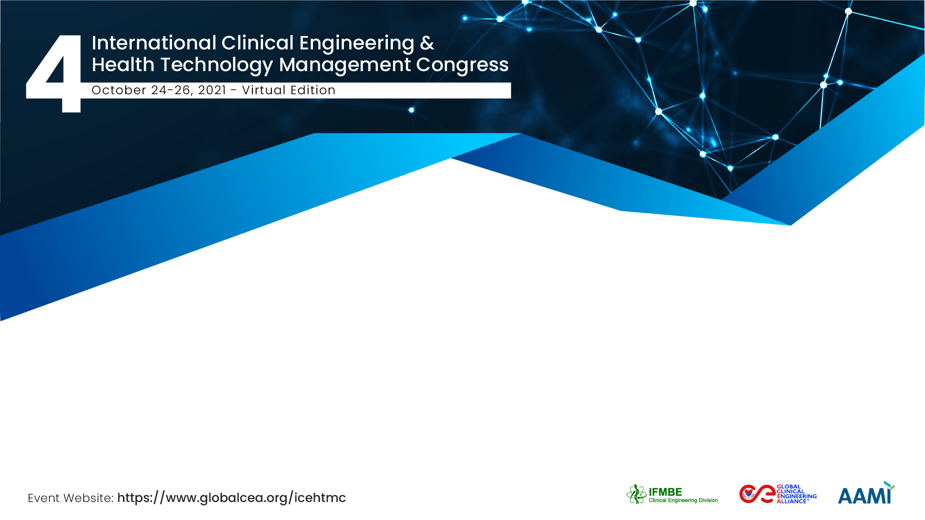
Telehealth in Development Countries: Peru & Paraguay in Covid-19’s context
Rossana Rivas, Pedro Galván
WHO Collaborating Center for HTM, UVM, US-Consultant; CED-IFMBE Collaborator Member & Hacking. Covid-19 Team; CE Head-Universidad Peruana Cayetano Heredia, PERU.
Biomedical Engineering Head, Health Sciences Research Institute (IICS), Universidad Nacional de Asunción (UNA), Telemedicine Director, Ministry of Health, PARAGUAY.

Slide 2
The Team / Workgroup
Rossana Rivas, Consultant at WHO Collaborating Center for Health Technology Management, UVM, US; CED-IFMBE Collaborator Member & Hacking Covid-19 Team; Clinical Engineering Head, Universidad Peruana Cayetano Heredia (UPCH), PERU.
Pedro Galván, Biomedical Engineering Head, Health Sciences Research Institute (IICS), Universidad Nacional de Asuncion (UNA); Telemedicine Director, Ministry of Public Health, PARAGUAY.

Slide 3
Description
Despite limitations: lack of regulation, insufficient number of health staff trained, low level of infrastructure, etc. the Americas Region experiments a sustained and rapid development of Telemedicine, the process increased in Covid19’s pandemic.
Some drivers observed in the global process are: the low level of accessibility to healthcare services before the pandemic and later the Covid-19’s health and economic effects of the lockdown.

Slide 4
Goals of the project and final users benefit
Benefits
Enhance global awareness and engagement of patients and health professionals’ regarding the Telehealth’s value and challenges.
Contribute to Telehealth’s Public Health System effectiveness in developing countries.
Facilitate the health stakeholders and community’s global networking by divulgating best practices on Telehealth applied to Covid-19’s priorities in developing countries.

Slide 5
Results: Peru
Government transferred US$ 37 millions to strength Telehealth, Electronic Health Record & Electronic Prescription at the national level (2021).
The National Digital Transformation System and the Digital Trust Framework to prevent digital risks were stated by Peruvian Government (2020).
Responding to Covid-19’s needs, since 2021, public entities must convert their administrative procedures to digital platforms or services. Also 100 public services were prioritized to be digitized.
National Telehealth Network articulates 25 regions of the country: 396 public health organizations among Peru (2021).
National Telehealth Network: S. Canto, Ministry of Health of Peru, 2021

Slide 6
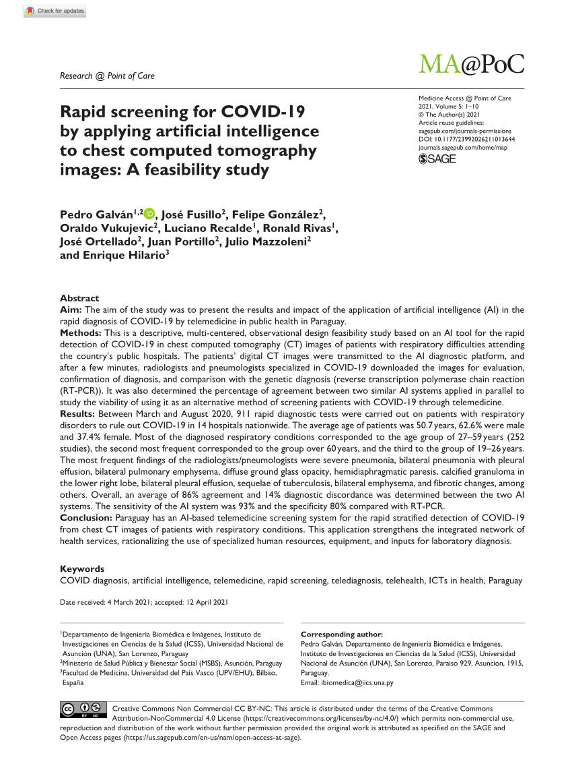
Results: Paraguay
The Artificial Intelligence (AI) Diagnosis System was developed by a multidisciplinary group of researchers, including pneumologist, radiologist, cardiologist, biomedical computer scientist, biomedical and clinical engineers.
The multicenter developed AI-enhanced telemedicine tool can determined a risk stratification of patients, to decide which type of care they need individually.
The AI system based on telemedicine platform perform COVID-19 diagnosis at district and regional hospitals across the country.
“Diagnosing Covid-19 using Artificial Intelligence” to offer diagnostic platform to enhance the capabilities of medical imaging diagnosis and speeding the delivery of chest image diagnosis for suspected COVID-19 patients, rationalizing scarce RT-PCR and specialized human resources in Paraguay.
Galván, P., et al.,. (2021). Rapid screening for COVID-19 by applying artificial intelligence to chest computed tomography images: A feasibility study. Medicine Access@ Point of Care, 5, 23992026211013644

Slide 7
Rossana Rivas
rivasperupucp@gmail.com
WHO Collaborating Center for HTM, UVM, US; Clinical Engineering Head, Biomedical Engineering Undergraduate Program, UPCH University; PERU.
Pedro Galván
ibiomedica@iics.una.py
Telemedicine Directorate, Ministry of Public Health and Welfare (MSPBS) / Department of Biomedical Engineering and Images (IICS-UNA); PARAGUAY.

