Slide 1
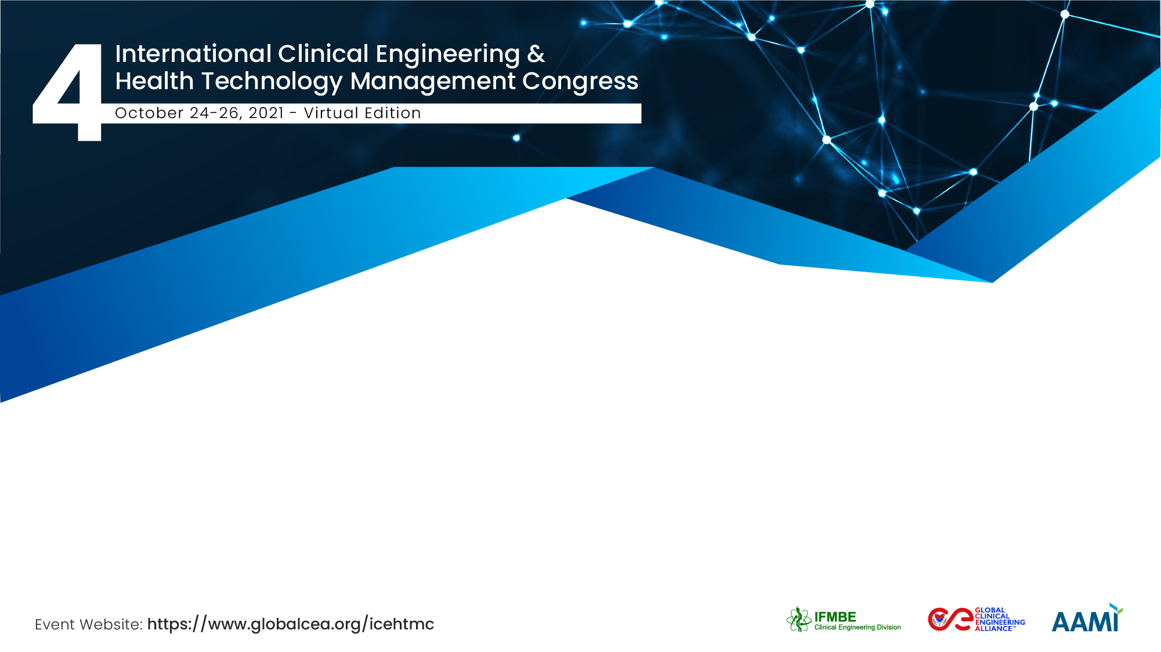
Telemonitoring in Cystic Fibrosis
Clinical Engineering's Contribution to Success Using The NASSS-CAT Framework
Michael Duane
Principal Clinical Engineer, Department of Medical Physics and Clinical Engineering &
Clinical Liaison, Health Innovation Hub Ireland,
Galway University Hospital, Ireland

Slide 2


The Team / Workgroup
Michael Duane, Brendan Tuohy, and Frank Kirrane; Clinical Engineering at Galway University Hospital
Members of the Respiratory Medical team
Physiotherapy Department all at Galway University Hospital
Patients using the system

Slide 3

Description
The rapid acceleration of out of hospital remote care technologies
Clinical Engineering
Opportunities exist for Telemonitoring implementations
Telemonitoring initiatives have typically tended to be ad-hoc and isolated to individual pilot sites.
Adopting a framework which can surface complexity

Slide 4
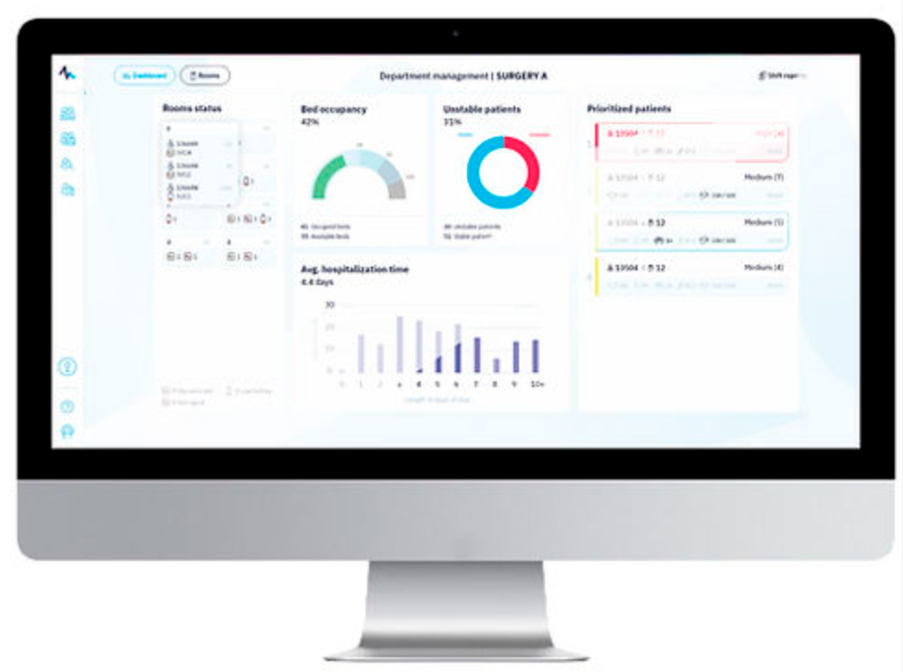
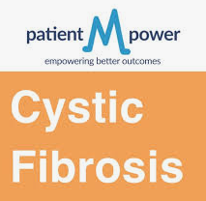
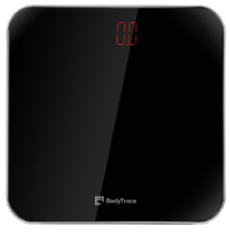
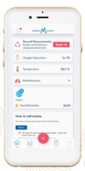


Goals of the project and final users that will benefit
To address the waiting list demand
Urgent need to monitor and care for Cystic Fibrosis patients isolated at home.
Home Monitoring Equipment
Better Access, increased convenience, reduced travel times, cost savings
Moving the complexity from the hospital to the home

Slide 5
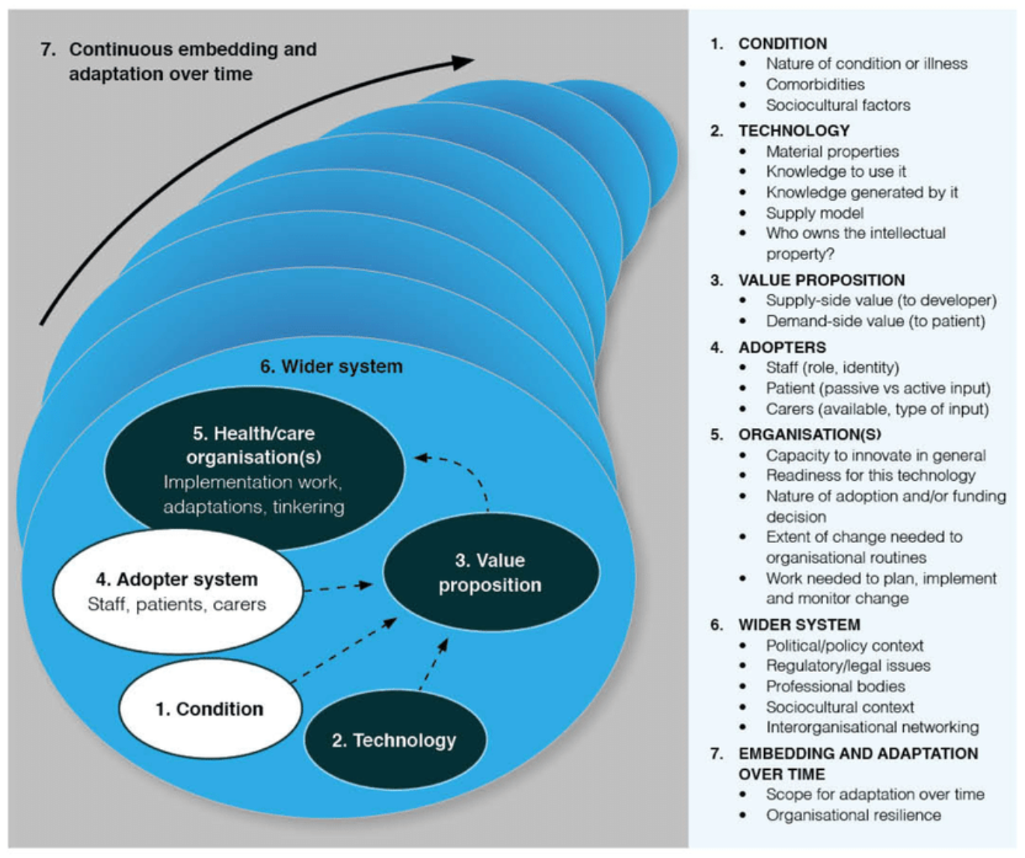
Goals of the project and final users that will benefit
NASSS – CAT Framework
Nonadoption Adoption Scale Spread Sustainability
Complexity Assessment Tools
NASSS-CAT Framework
  7 Domains
Complexity
Understanding the affects of complexity in a project
Complexity Classification ( Simple, Complicated, Complex)
Intuitive and easy to use
Greenhalgh, T., Wherton, J., Papoutsi, C., Lynch, J., Hughes, G., Hinder, S., Fahy, N., Procter, R. and Shaw, S., 2017. Beyond adoption: a new framework for theorizing and evaluating nonadoption, abandonment, and challenges to the scale-up, spread, and sustainability of health and care technologies. Journal of medical Internet research, 19(11), p.e367.

Slide 6

Results
Over 70 very vulnerable patients have been discharged to their home
Routine outpatient consultations are now provided remotely.
The NASSS-CAT framework
Understanding of the complexities

Slide 7

Results
A summary of the issues that Clinical Engineering had direct input in are:
Selection and commissioning
Technology readiness
Home spirometry measurement
Design and configuration changes.

Slide 8
Michael Duane
michael.duane@hse.ie
Department of Medical Physics and Clinical Engineering
Galway University Hospital, Ireland

