Slide 1

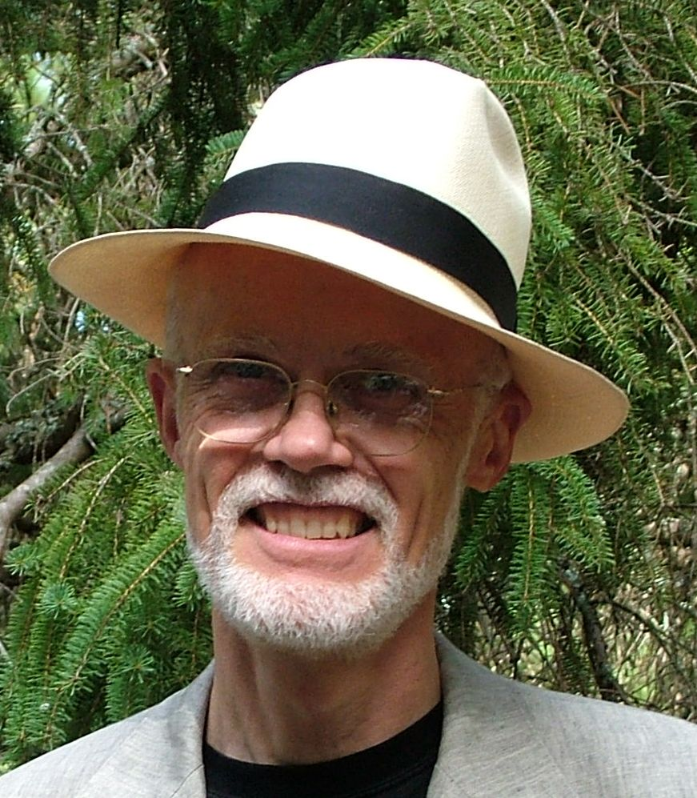
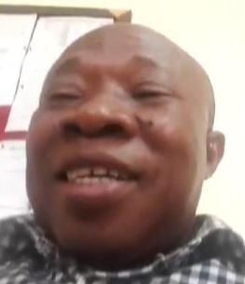
The Ingenuity of Clinical Engineers Maintaining Equipment with Limited Resources - Examples from Ghana
Bill Gentles
Chair, CMBES International Outreach Committee
John Zienaa
Chief Clinical Engineering Manger
Clinical Engineering Department
Ghana Health Service

Slide 2
The Team / Workgroup
Bill Gentles(1), John Zienaa(2), Kwabena Debrah(2), Clement Appiah(2)
(1) Canadian Medical & Biological Engineering Society,
(2) Ghana Health Service, Clinical Engineering Department

Slide 3
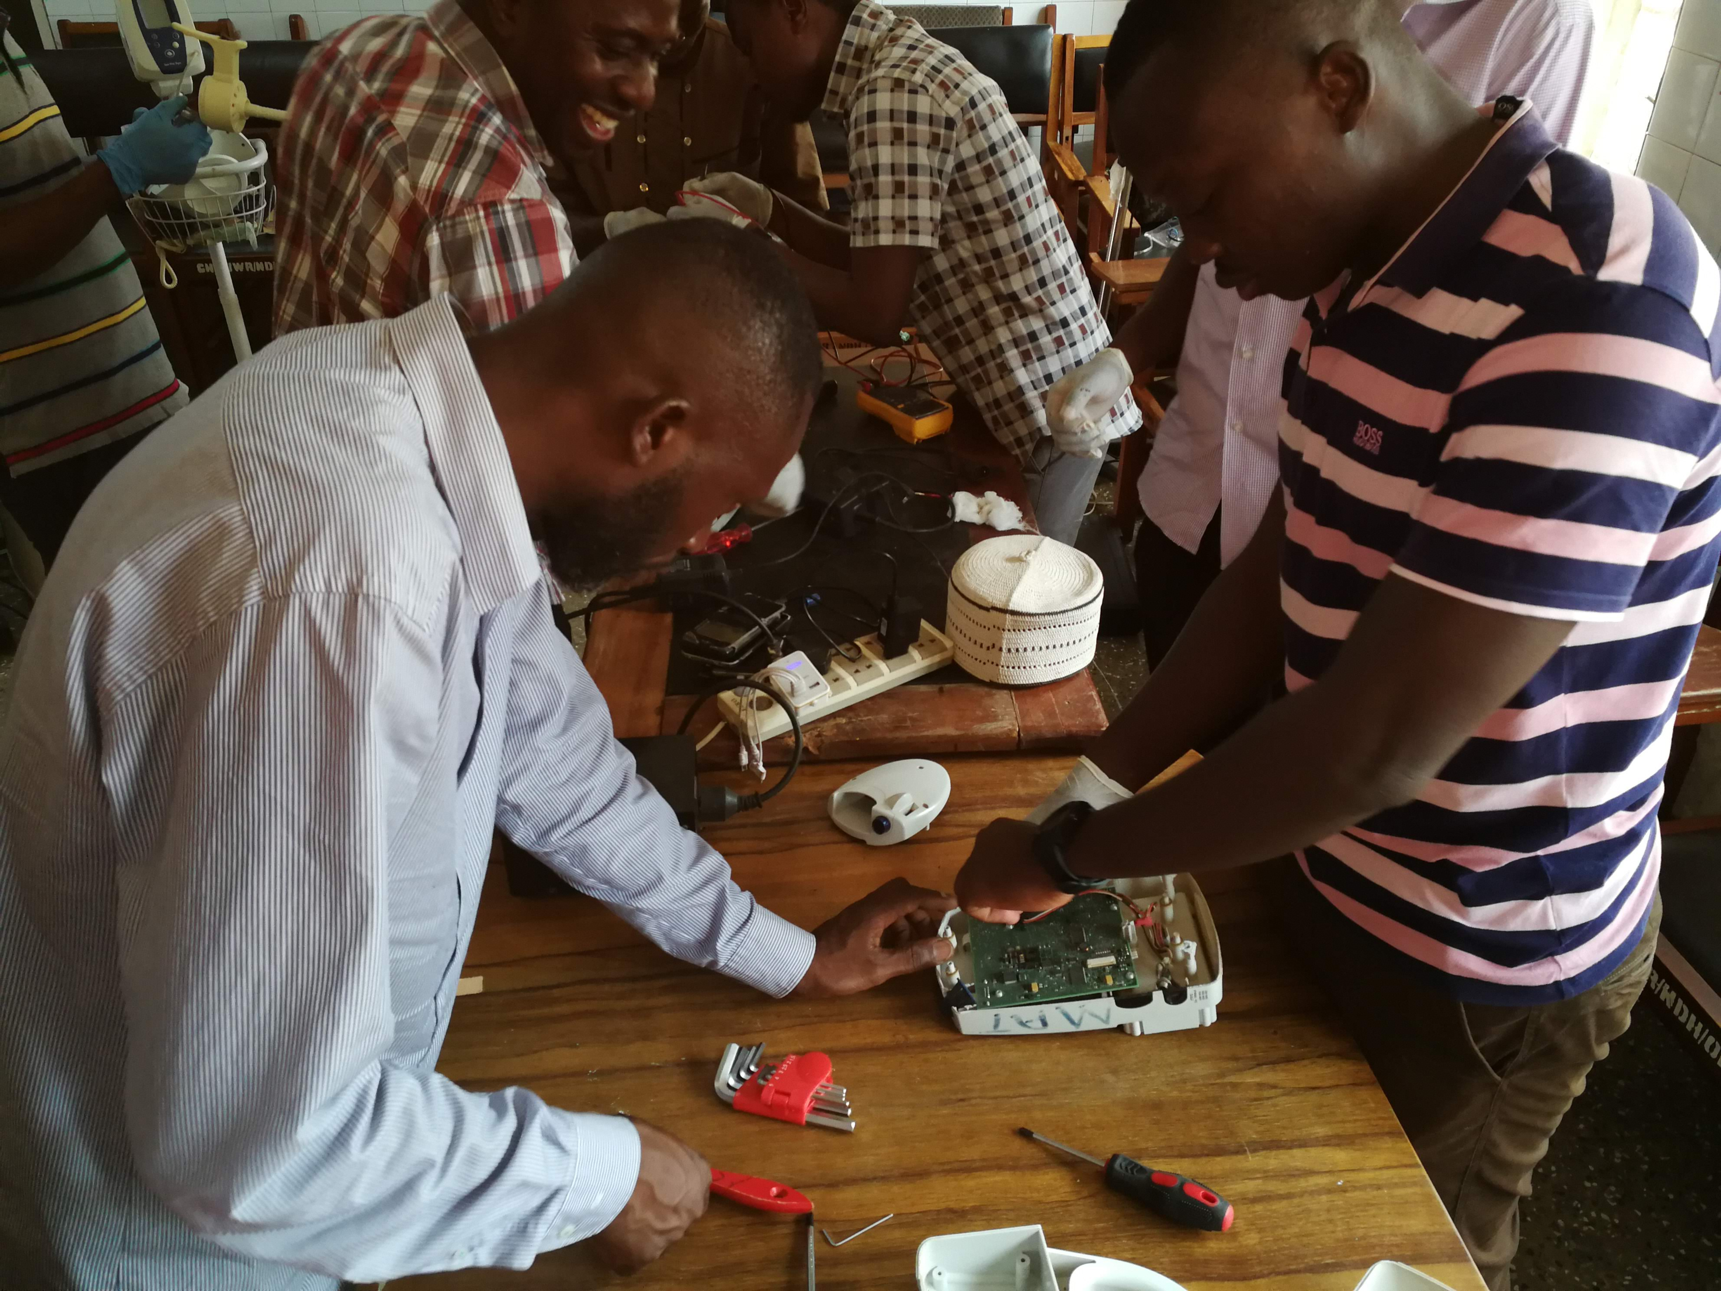
Description
Clinical engineers working in low resource countries face many challenges. One of those is the difficulty in obtaining repair parts for equipment, especially when the equipment has been donated by a distant country. Meeting this challenge requires creativity and ingenuity that differs from the challenges faced by Clinical engineers in developed countries.
The examples in this presentation came out of a call for problem solving challenges faced by Clinical engineers in Ghana, as part of a series of webinars presented to Ghanaian Clinical Engineers in collaboration with the charity Ghana Medical Help and the International Outreach Committee of the Canadian Medical & Biological Engineering Society (CMBES).
Notes:
These examples illustrate innovative solutions to the lack of available spare parts, or in one case, the inappropriateness of the design for the local environment.

Slide 4
Goals of the project and final users that will benefit
The goal of this Project was to share accomplishments among the Clinical Engineering professionals in Ghana.
The creativeness and ingenuity demonstrated in these examples will also raise the profile of the clinical engineering profession in Ghana.

Slide 5
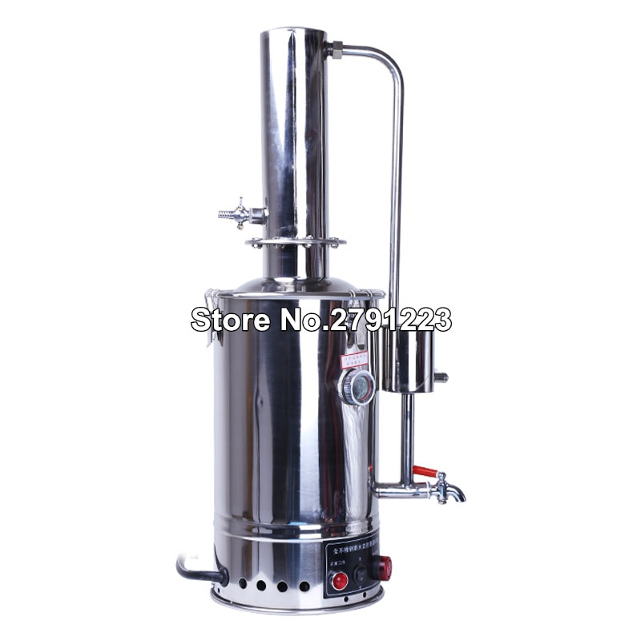
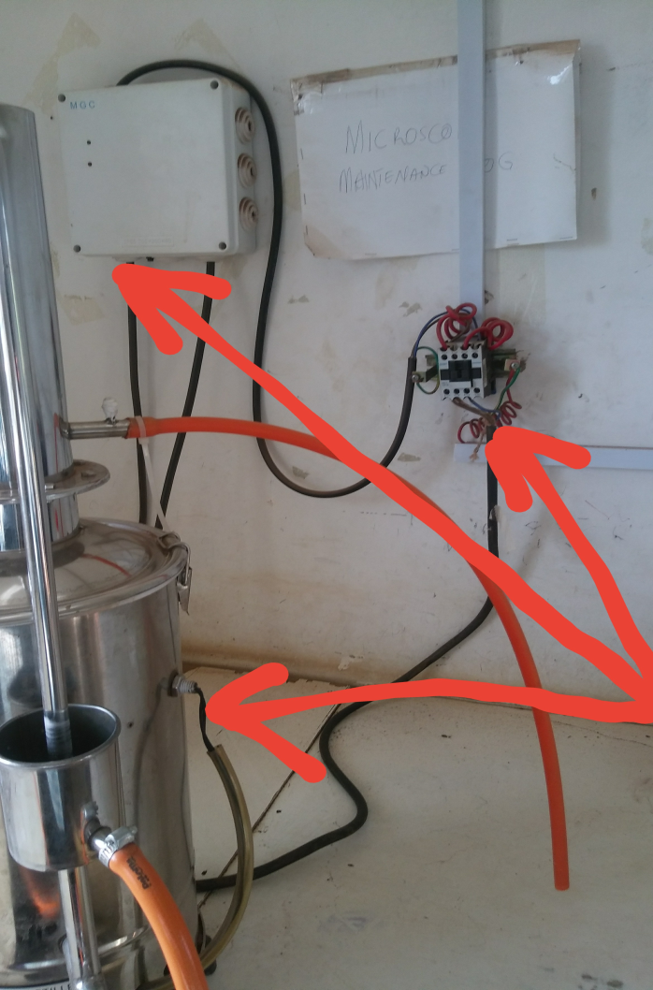
Results – Case 1
Problem:
A distiller repeatedly has a burned-out heating element due to interruptions in the water supply.
Solution:
Install a water level sensor in the wall of the distiller, and through an external circuit, drive a relay which would disconnect the power to the distiller when the water dropped below a safe level.

Slide 6
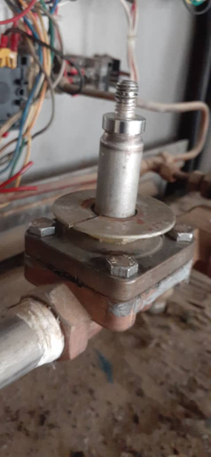
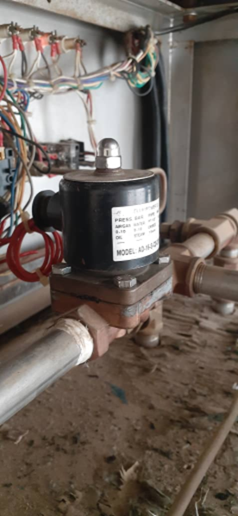
Results – Case 2
Problem:
An autoclave had four solenoid valves that had failed, and replacements were unavailable.
Solution:
Machine new plumbing fittings locally to adapt locally available valves to the existing piping.

Slide 7
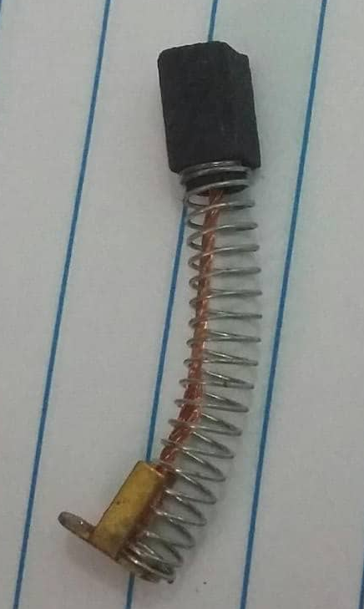
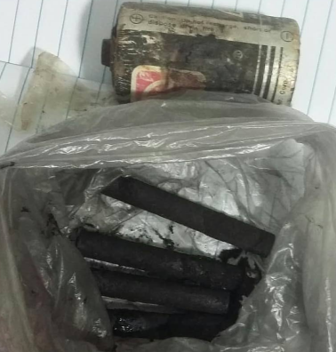
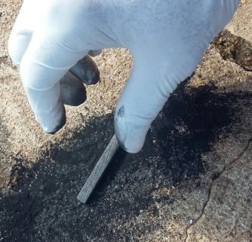
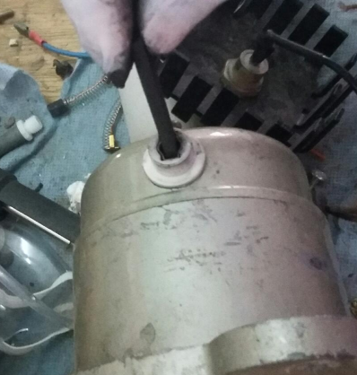
Results – Case 3
Problem:
The brushes in a centrifuge motor were worn out and replacement brushes were unavailable.
Solution:
Replacement brushes were fabricated by disassembling D-cell flashlight batteries and removing the central carbon rod that makes up one electrode of the battery. This cylindrical rod was then cut to the appropriate length and shaped to the same profile as the old brushes.

Slide 8
Bill Gentles
John Zienaa
billgentles@sympatico.ca
Canadian Medical & Biological Engineering Society (CMBES), Canada
zienaaj@yahoo.co.uk
Clinical Engineering Department,
Ghana Health Service

