Slide 1
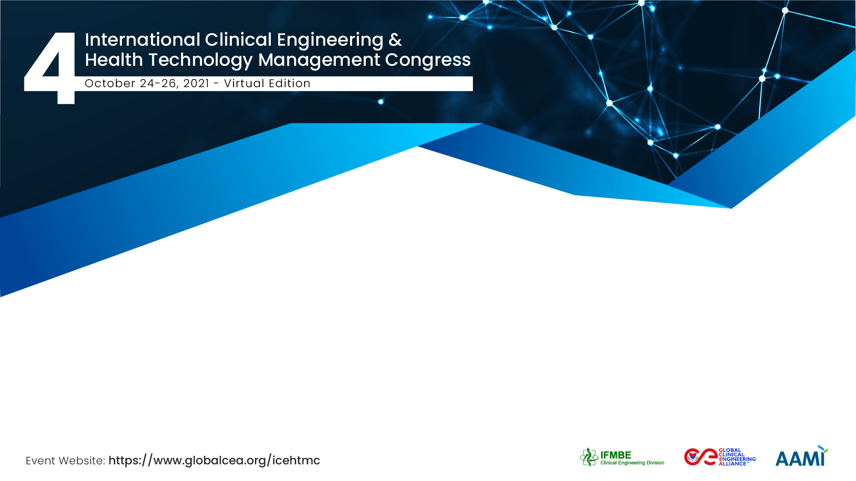
The Power of N.E.R.D.S.
Better Healthcare through Better Data
Eric Rosow
CEO, Diameter Health
Notes:
Hello. My name is Eric Rosow and I’m honored to be part of the Industry Innovations track in this year’s International Clinical Engineering and Health Technology Management Congress.
My presentation, entitled “The Power of N.E.R.D.S.” is all about data quality and how how Better Healthcare is enabled through better data.

Slide 2
Team Diameter
Diameter Health’s mission is to power the healthcare ecosystem by making data universally accessible, organized and actionable.
Notes:
I am a co-founder and serve as CEO of a company called Diameter Health.
Diameter Health’s mission is to power the healthcare ecosystem by making data universally accessible, organized and actionable.
New venture creation is definately a team sport so I wanted to include this image to acknowledge all the members of our team that share our vision and mission.

Slide 3
The Challenge
Clinical Data is…
Increasing in volume.
Increasing in accessibility.
Increasing in value.
However, it is also…
Not standard.
Not analytics-ready, machine-readable.
Not interoperable.
50%
of clinical data is non-standard or incomplete and thus not usable at scale
70%
of lab results do not include appropriate vocabulary or units
Up to 40%
of medications do not have appropriate coding for quality measurement
Notes:
The Challenge our company addresses is:…

Slide 4
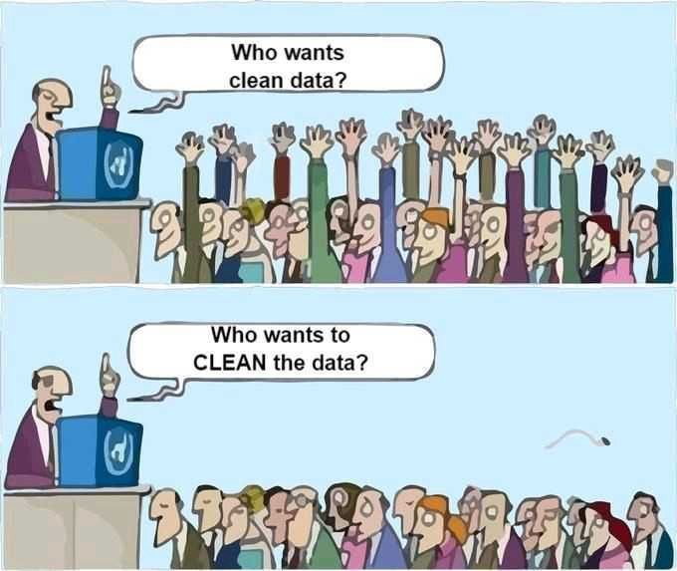
Simply Put…
Notes:
Simply, put everyone wants and appreciates the value of clean data, but at that same time, people also appreciate how challenging and time consuming it can be to actually clean the data…

Slide 5





The Data Refinery
Diameter Health has developed an automated API called Fusion that provides a single source of truth, unifying and enriching clinical data across types, standards and formats to enable intelligent and seamless data exchange and accelerate enterprise outcomes.
The Pipes
The Refinery
The Car
Transports crude clinical data from source to where it’s needed
Creates high-octane fuel from unrefined clinical data
Uses the fuel to drive improvements in healthcare
Notes:
To that end, we’ve developed a “data refinery” through an automated API we call Fusion.
Fusion provides a single source of truth, unifying and enriching clinical data across types, and standards and formats to enable intelligent and seamless data exchange and accelerate enterprise outcomes.
To use a non-carbon friendly analogy, we think of clinical data as ”digital crude oil” that needs to be refined into high octane fuel that can in turn power a myriad of different downstream “engines” or use cases.

Slide 6
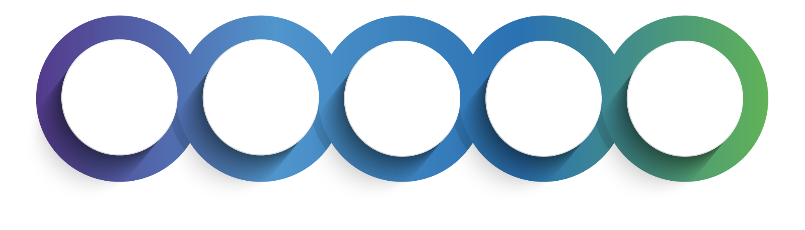
“NERDIFY” the Data
5-Step Clinical Data Optimization Process: Parse & Aggregate Data in Real-Time, At Scale
NORMALIZE
ENRICH
REORGANIZE
DEDUPLICATE
SUMMARIZE
Normalize clinical data to industry standards and improve quality.
Enrich with appropriate metadata for downstream use.
Reorganize clinical document data to appropriate sections.
Deduplicate repetitive data elements across and within data sources.
Summarize data into longitudinal patient records.
Notes:
At the heart of our Fusion API are what we affectionately refer to as our NERDS. Nerds is an automated 5-step data optimization process that stands for…
And each of these 5 steps are essential to fully leverage clinical data.

Slide 7
“Uplift” the data to address systemic Variation
Variation in how results are coded and structured is resolved to a single value that can be recognized by downstream systems.
Notes:
Here is an example of how our NERDS “uplift” clinical data and reduce variation. For a measure as basic as an HbA1c, over 40% of the samples did not use the standard of LOINC and there were over 50 different uncoded textual mappings.
By running this disparate set of data through Fusion, we were able to consolidate all of those entries into a single standard code and unit—in this case LOINC code 4548-4.

Slide 8
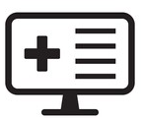
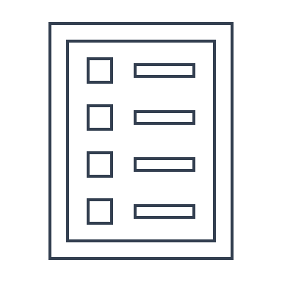


Representative Results: Health Information Exchanges
Data Uplift Analysis (HIE #1 with multiple EHR sources)
Data Uplift Analysis (HIE #2 with multiple EHR sources)
20
Electronic Health Records (EHRs)
860,000
Continuity of Care
Documents (CCDs)
>5M clinical
data elements
14,880
Continuity of Care Documents (CCDs)
8,994
Patients
>5M clinical
data elements
Notes:
Here are two more examples of larger data sets from two of our Health Information Exchange clients. You can see by the dark blue portion of each bar, that in many instances we were able to uplift additional data sets including allergies, encounters, problems, results and vital signs.

Slide 9
Example of Enriched Clinical Data
Hundreds of unique codes and text tagged for clinical query
carvedilol
Find me all patients on a beta blocker… from a single field
propranolol
bisoprolol
Dutoprol (Brand)
Lopressor (Brand)
esmolol
Lopressor HCT (Brand)
metipranolol
Toprol (Brand)
metoprolol
chlorthalidone / metoprolol
acebutolol
felodipine / metoprolol
labetalol
hydralazine / hydrochlorothiazide
/ metoprolol
pindolol
timolol
hydrochlorothiazide / metoprolol
levobunolol
carteolol
betaxolol
nadolol
metoprolol / nifedipine
penbutolol
atenolol
Notes:
So why is this important?
Well, normalizing the data into a single concept allows us to ask questions that can be quickly answered as show here…

Slide 10
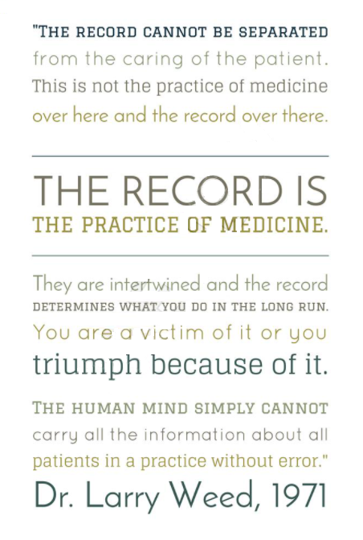
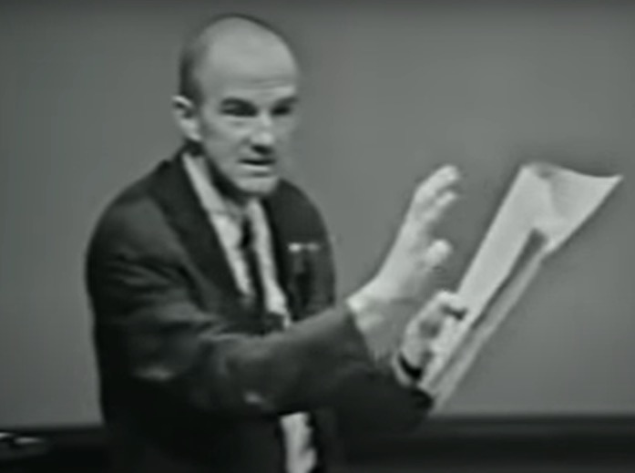
Making the Record Actionable
Healthcare is a fifth
of US GDP
Medicine is complex.
At its essence, medicine is an information science
Organizing the medical record fuels better quality and reduced costs
Diameter Health was founded to improve healthcare data
Larry Weed, MD, Emory Grand Rounds, 1971 https://www.youtube.com/watch?v=qMsPXSMTpFI
Notes:
In conclusion, this work is all about making the record actionable.
Healthcare is a fifth of the US GDP…
This is not a new concept and I wanted to share a wonderful grand rounds presentation from over 50 years ago by Dr. Larry Weed from the University of Vermont Medical Center who so eloquently spoke to the fact that the RECORD is the practice of medicine and how the human mind simply cannot carry all the information about all patients in a practice without error.
Ultimately, as part of the healthcare ecosystem we will either be a victim of poor data quality or we will triumph because of high data quality.

Slide 11
Eric Rosow
Thank You!
erosow@diameterhealth.com
Diameter Health
www.diameterhealth.com
USA
Notes:
I thank you for your attention and here is my contact information in case anyone has any follow up questions.
Thank you again for opportunity and I hope you enjoy the balance of the Congress.

