Slide 1
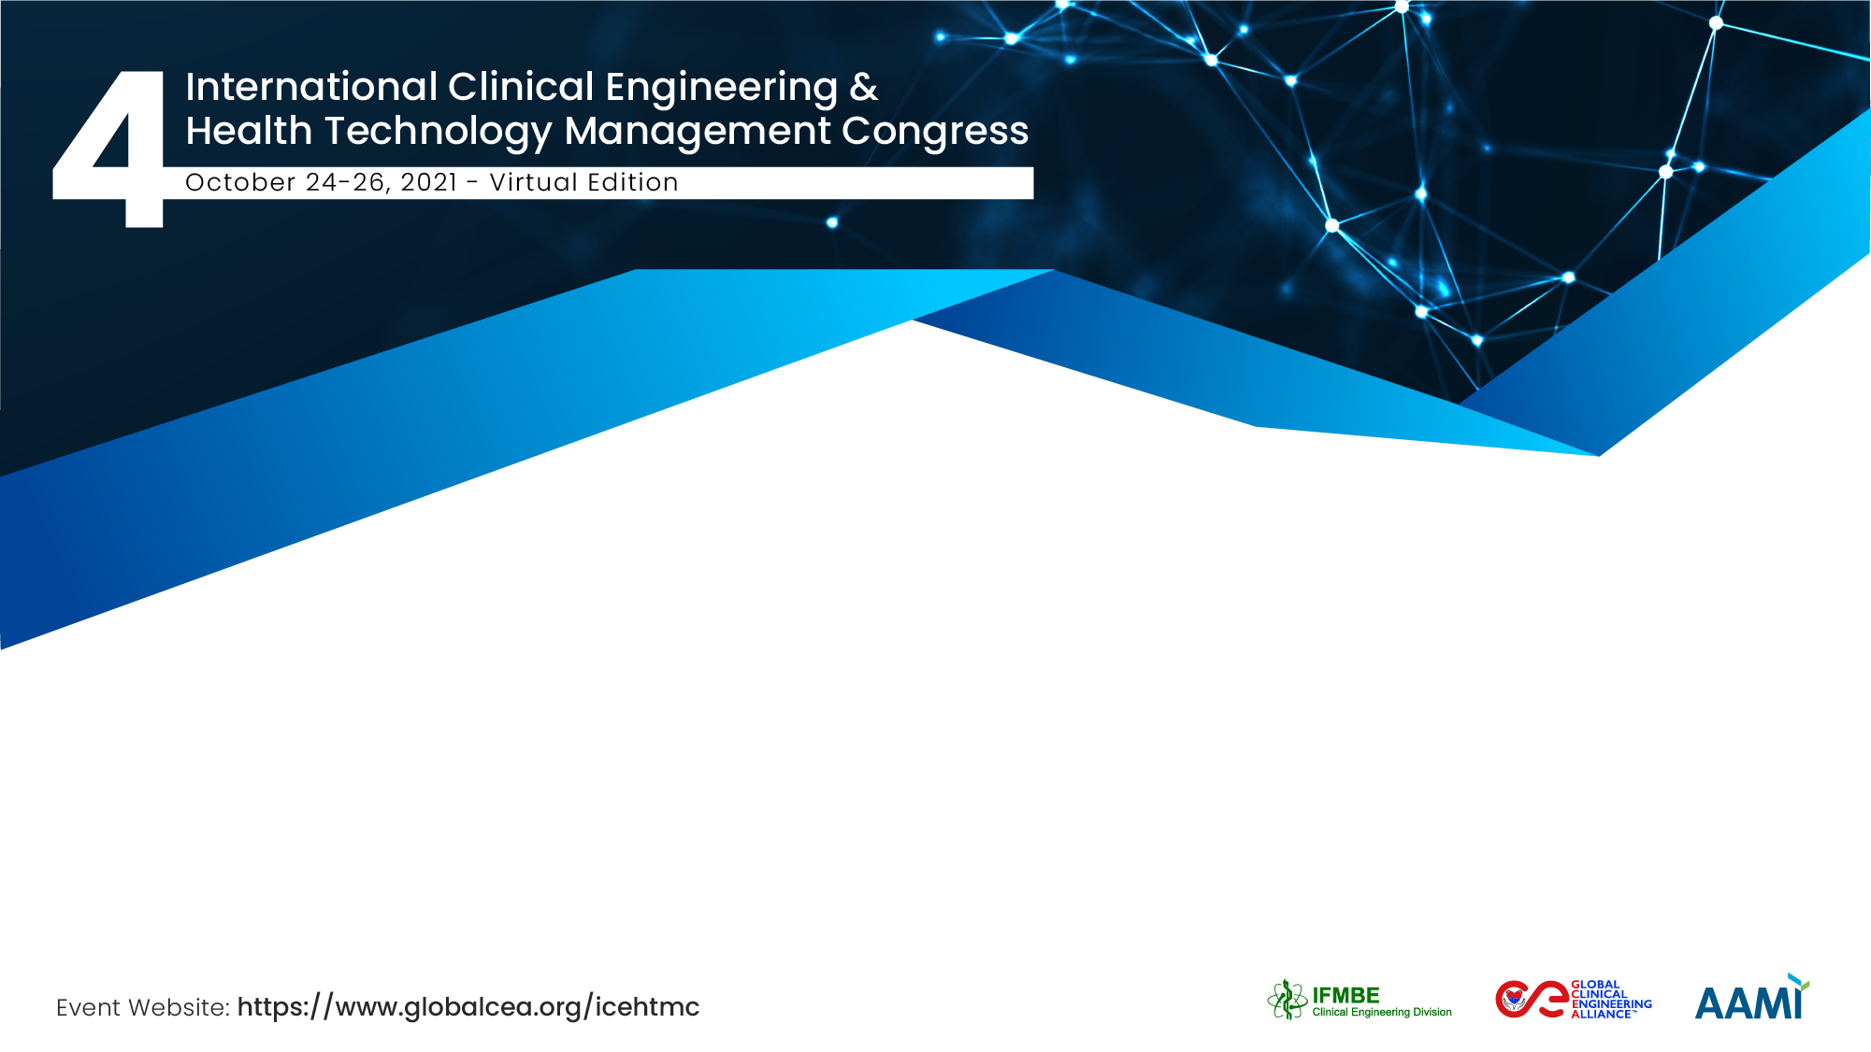
The importance of a comprehensive global policy template for medical devices safety and optimal outcomes
Leo Lehtiniemi, Sociologist, Public Policy Expert
Brian Moher, Lawyer-Barrister
Ed Napke, MD, DPH, retired Drug Adverse Event Expert, WHO
Michael Cheng, retired Clinical Engineer, IFMBE/CED Collaborator

Slide 2
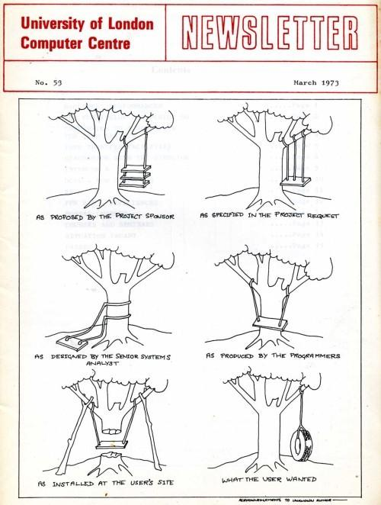
Muti-Disciplinary Work
Multi-disciplinary reality - as seen 50 years ago when things were much simpler.
The challenge is exponentially greater in the more complex 21st century.

Slide 3
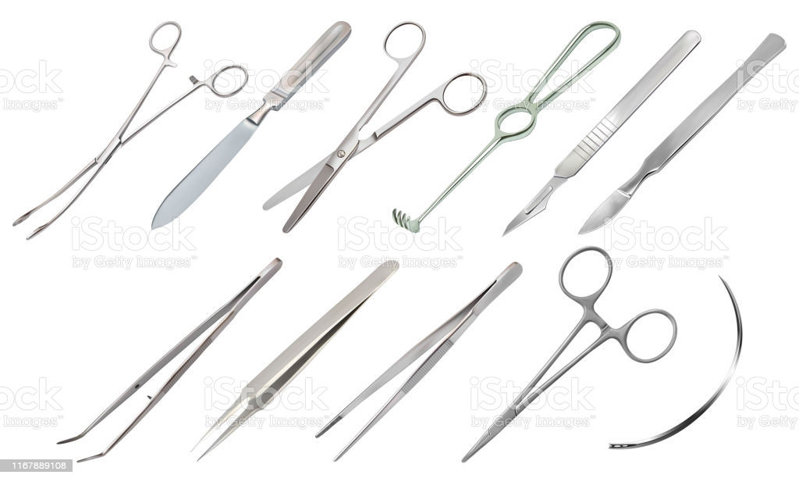
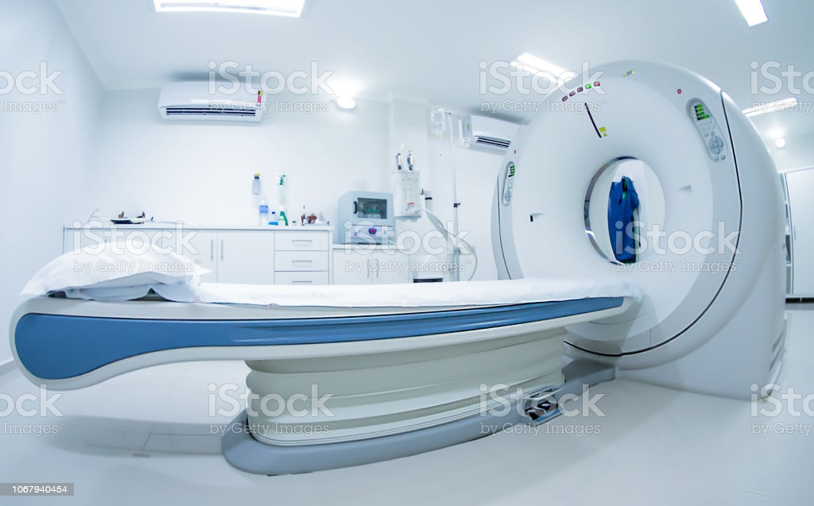
The SCOPE of what Medical Devices includes is extremely broad and diverse. It embraces devices as simple as needles for suturing and complex electronic machines such as those used for magnetic imaging.

Slide 4

Longitudinal Process
The LIFE CYCLE of many medical devices is typically long. It goes though a series of steps or stages from concept, design, testing, manufacture, distribution, installation, use, and maintenance or replacement. The full chain of processes usually spans many years.

Slide 5
PROFESSIONAL DIVERSITY = communication challenge
Specific professional expertise is essential at each stage in the development, design, manufacture, distribution, installation and use of devices.
Each professional field has specialized areas of expertise, different educational qualifications, skill sets and accepted methods and practices
Different professions often use their own specific technical terminology - a distinctive lexicon.
Different professions often use
  - the same words to mean different things, and
  - different words to mean the same thing.

Slide 6
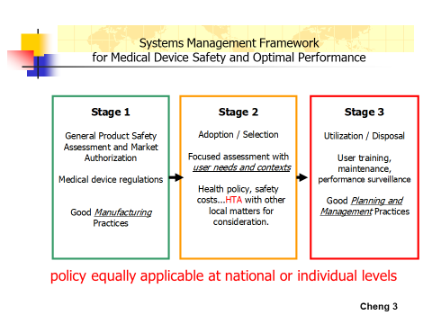
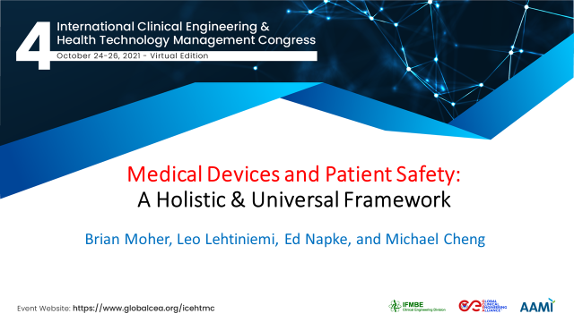
A common framework is important to facilitate shared understanding of all the parts and effective communication
See also presentation below
# 10763 at this same Congress

Slide 7
Take Away
The three stage Medical Devices Framework provides a “big picture” overview of the field to foster shared awareness and understanding of the whole process for more effective communication
It provides a useful tool to make sure everyone is on the same page
Senior policy makers and resource allocation decision makers at every level of health care - national, state/provincial/regional, or institutional - have a vital role in deciding what devices are procured, installed and used.
They need a clear grasp of the overall medical devices life cycle to understand the complete range of aspects that require attention. The three-step framework provides an easy-to-grasp big picture of the key aspects that must be examined to ensure safe outcomes from the use of medical devices.

Slide 8
Thank You

