Slide 1
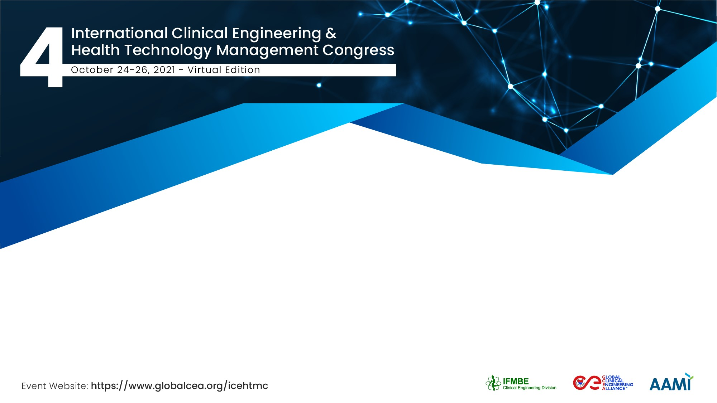
Training assurance on medical devices use
Germán Giles – Schiller Americas - USA
Marcelo Lencina – National Technological University – Regional San Nicolás - Argentina

Slide 2
The Team / Workgroup
Germán Giles – Schiller Americas - USA
Marcelo Lencina – National Technological University – Regional San Nicolas - Argentina

Slide 3
Description
Every day, more non-medical direct related people use different type of medical devices. As this trend will be increasing during the next years, the risks of using them in an inadequate way must be reduced.
Usual training types for medical related people are by manuals, in-service meetings, video platforms or any other way of learning, so the users can feel their readiness to start using them.
Depending on the level of complexity of the devices, several strategies can be followed to get the people trained. But sometimes that is not enough.
All type of users should receive also a certificate that can be shared electronically, as a proof or declaration of some type of training performed.
Government authorities should agree with manufacturers and other stakeholders, the ways on how to facilitate these tasks, and encourage the users to do it.

Slide 4
Goals of the project and final users that will benefit
Improve the Patient Safety.
Have data of trained users operating medical devices.
Take advantage of the technology to automate some process of registration, training and declaration of responsibilities, using those medical devices.
Introduce non-medical users on different types of policies, regulations and risks using the devices.
Reduce medical device use errors and downtimes.

Slide 5

Results
We found different ways to encourage stakeholders to work in policies to get the goals.
Eg. Schiller, a Swiss Cardiopulmonary device manufacturer, is working on the following App that will provide a simple tool to their users, where after reading the User Manual (in paper or digital format) and answering some questions- at least 70% of right answers must be reached-, the platform delivers a Certificate via email, so the users can show a proof of training to their patients.
www.schiller.us

Slide 6
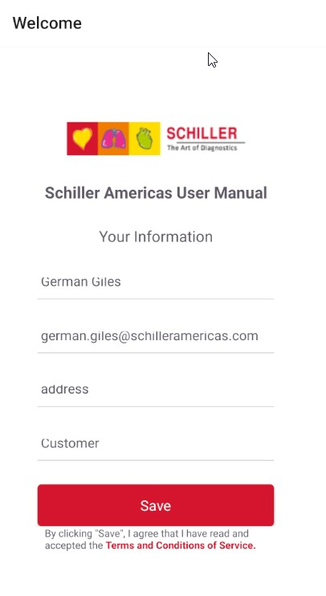
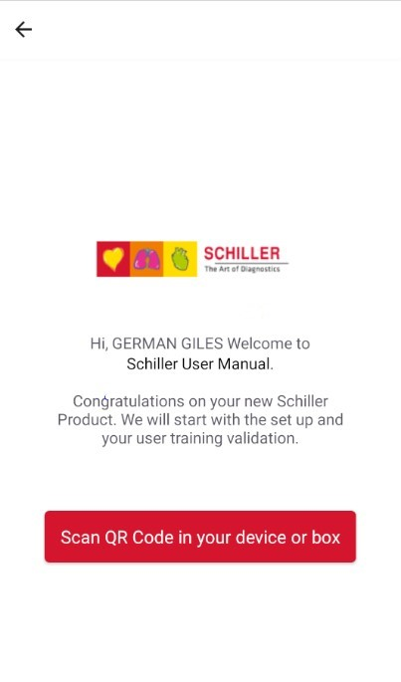
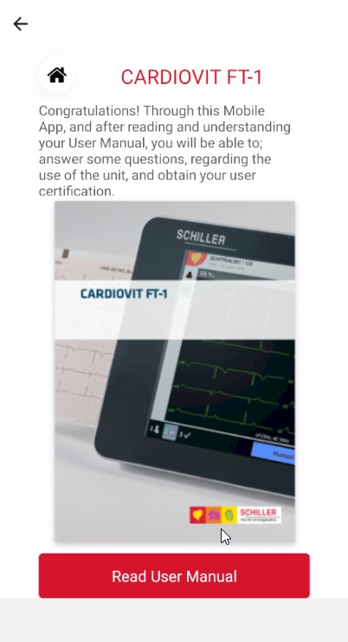
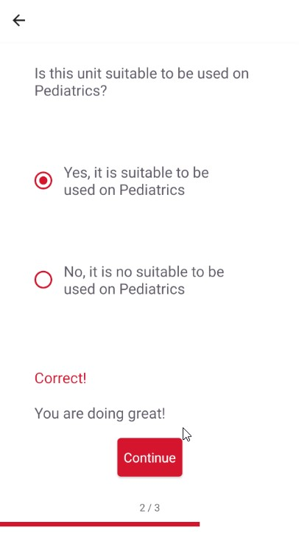

Slide 7
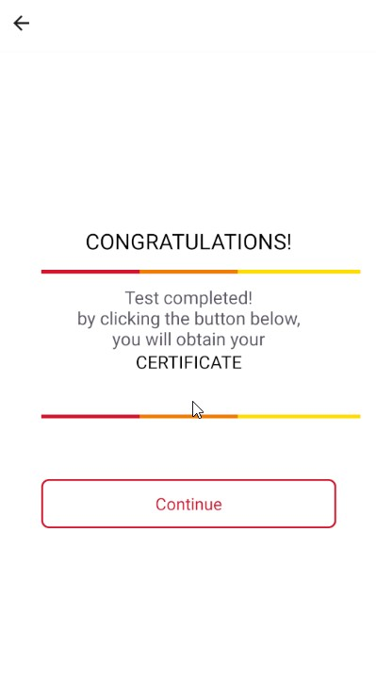
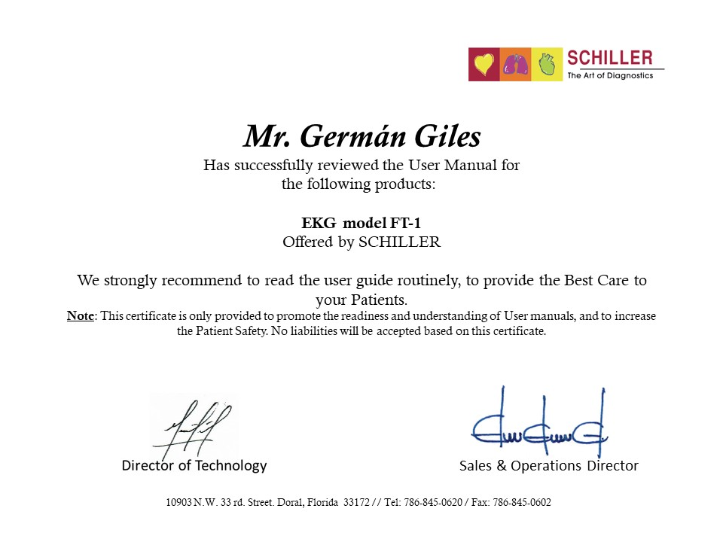

Slide 8
Germán Giles
german.giles@schilleramericas.com
Schiller Americas – USA
Marcelo Lencina
mhlencina@gmail.com
National Technological University – Regional San Nicolas - Argentina

