Slide 1
Training Strategy for Clinical Engineering
Albert Einstein Israelite Hospital
Clinical Engineering-Biomedical Instrumentation Group
Filipe Moreira Simionato,
Berthone Venancio Soares,
Daniela de Oliveira Canelas,
Everton Silva Viana Galvão,
Eduardo Henrique Gomes Generoso

Slide 2
Training Strategy for Clinical Engineering
This document presents a strategy for engaging and improving the quality of the Clinical Engineering team through training. The focus is on meeting the specific needs of employees, increasing technical knowledge and job satisfaction and thus ensuring safety in the use of equipment, benefiting users and patients.

Slide 3
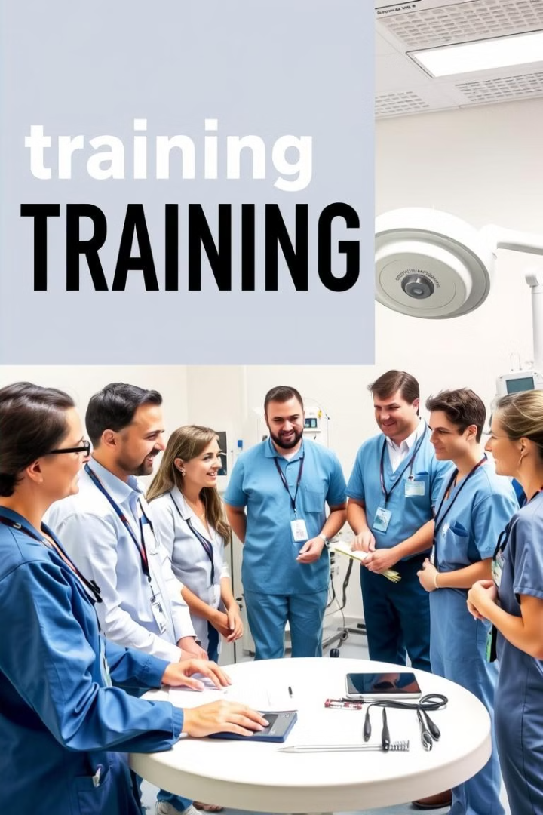
Understanding Team Needs
1
Institutional Climate Survey
Identification of areas for improvement in training strategies.
2
VOC Methodology
Gathering information about the actual training needs of the team.
Interviews and Questionnaires
3
Evaluation of current knowledge about equipment, routines and processes.

Slide 4
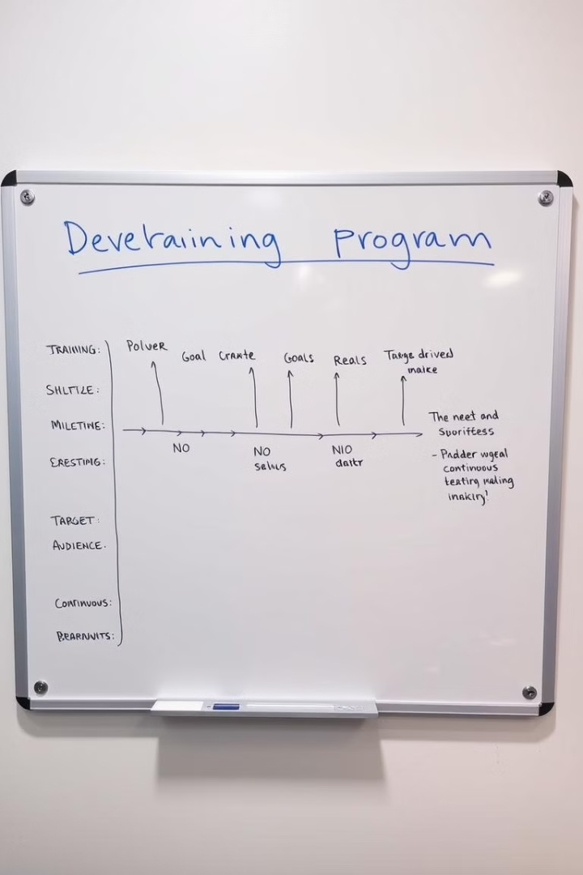
Defining Objectives and Goals
Increased Team Satisfaction
Improved perception of knowledge and skills in relation to equipment.
Feedback and Data Analysis
Collecting continuous feedback to identify areas for improvement and adjust trainings.
Ongoing Training
Implementing regular training programs to keep staff up to date.

Slide 5
Methodology and Implementation
1
Initial Phase: Evaluation
Individual interviews to identify employees' level of knowledge about equipment, routines, and processes.
2
Basic Training Phase
Implementation of training for areas with a higher rate of need for basic knowledge.
3
Advanced Training Phase
Specific and technical training for employees who have demonstrated mastery in basic callings.

Slide 6
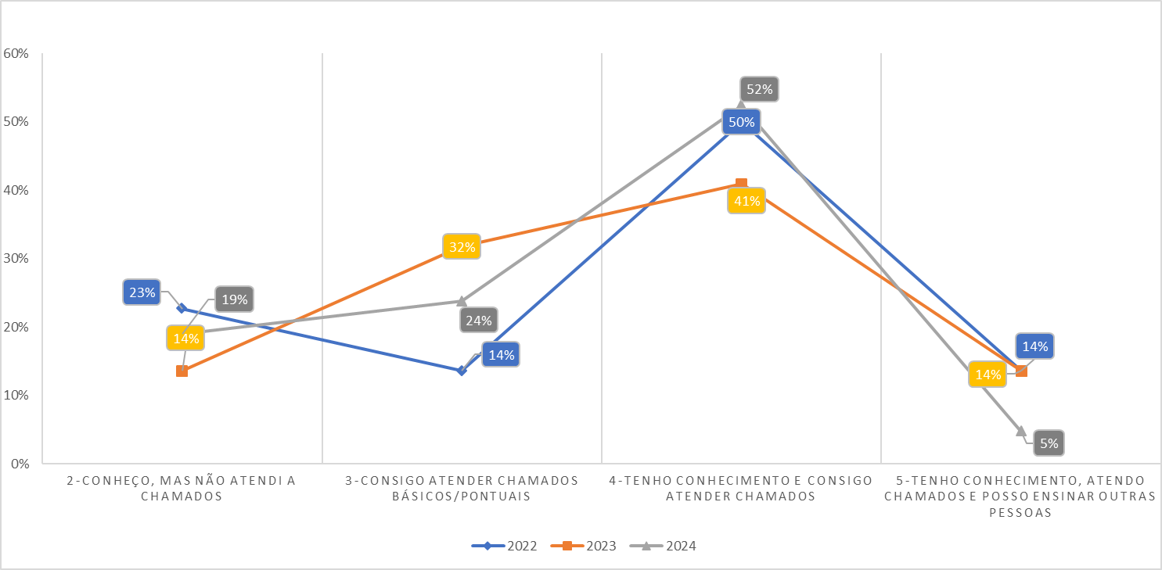
Analysis and Results

Slide 7
Analysis of the Pre-VOC Situation
Basic Knowledge
Training Required
Initial Methodology
Less than 30% of employees demonstrated basic knowledge about the equipment, indicating the need for more comprehensive training.
The need for basic training in various areas, especially in equipment and processes, has become evident.
The initial methodology was based on face-to-face interviews to assess the level of knowledge of employees, a slow and inefficient process.

Slide 8

Positive Results of the VOC Methodology
1
Evolution of Knowledge
With the implementation of the VOC Methodology, more than 50% of the team now feels confident to solve complex problems related to equipment.
2
Increased Confidence
Employee perceptions have evolved from "basic knowledge" to "effective skill" in handling equipment, reflecting the effectiveness of training.
3
Positive Impact
The increase in employee satisfaction and competence in relation to the training carried out shows the success of the VOC Methodology.

Slide 9
Positive Impact of Training
Increased Confidence
Improving the Quality of Work
Professional Satisfaction
Employees feel more confident to handle equipment, solving complex problems and offering effective solutions.
The knowledge acquired allows the team to carry out the work more efficiently, minimizing errors and increasing the quality of customer service and patient and user safety.
The team feels valued and motivated by the investment in their professional development, increasing engagement and productivity.

Slide 10

Conclusion
The implementation of a training program based on the VOC methodology is critical to the success of the Clinical Engineering team. Investment in training and professional development ensures a high level of knowledge, improving the quality of work and increasing team satisfaction. The culture of continuous learning is essential to keep the team prepared for the challenges of the market and ensure excellence in Clinical Engineering services.

