Slide 1
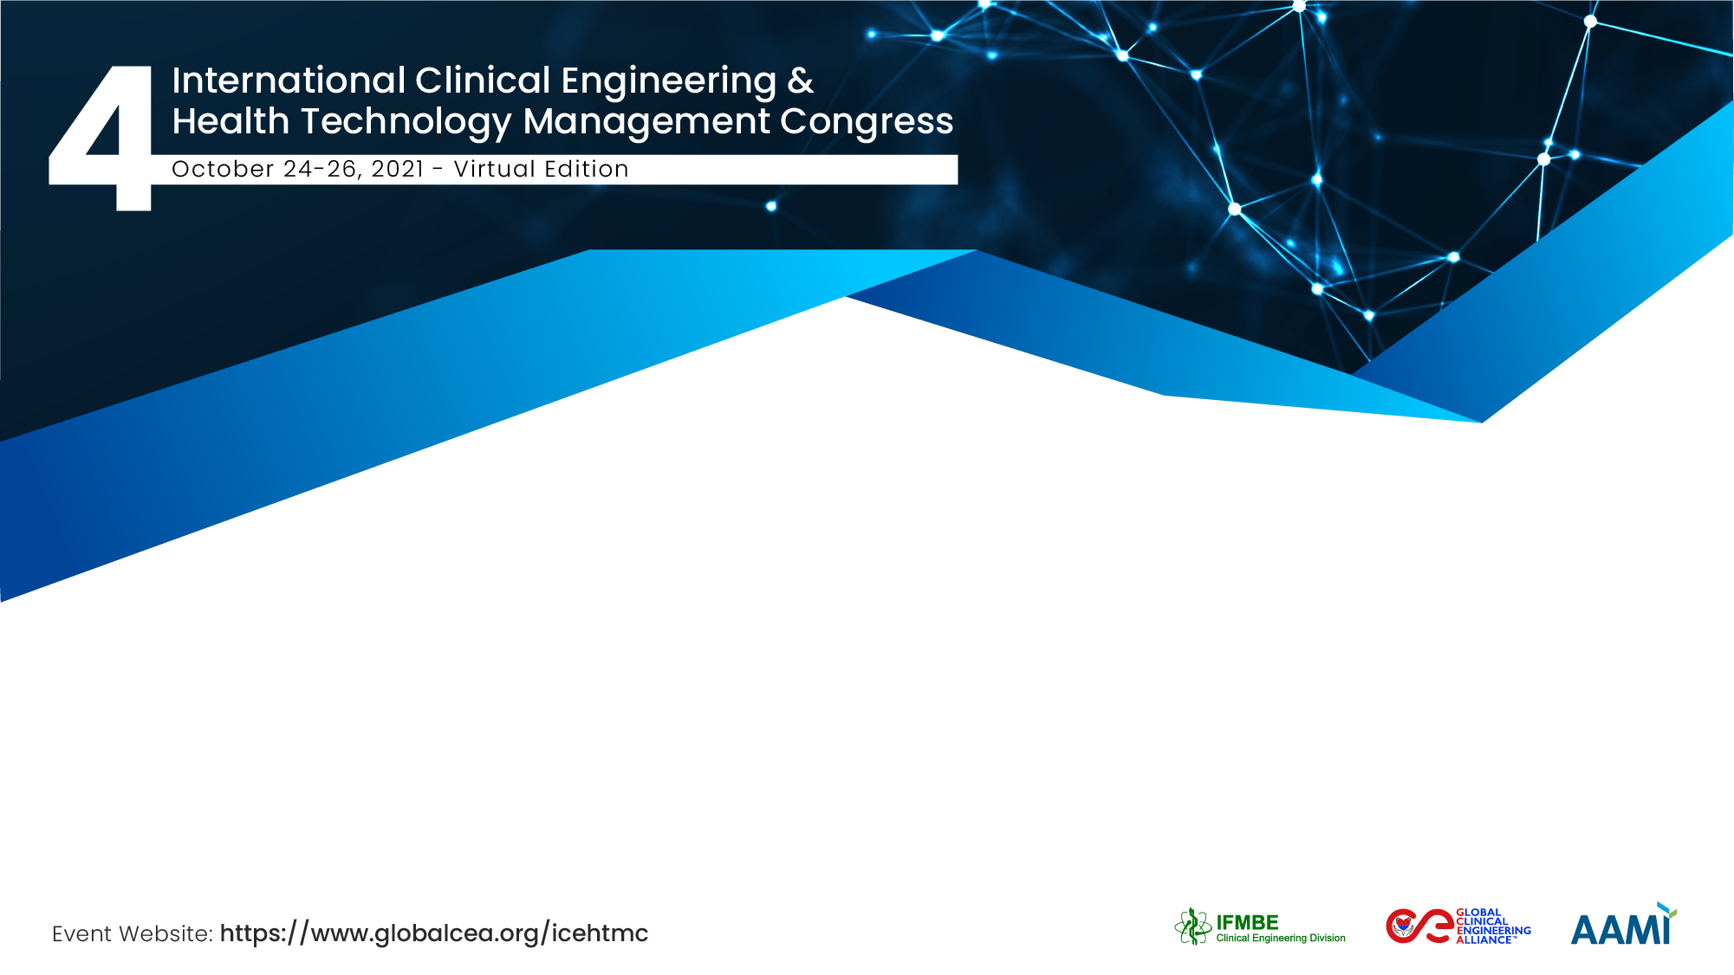

Using Artificial Intelligence for COVID-19 diagnosis
Pedro GALVAN, ScD., Dipl.-Ing. Biom.
IICS-UNA / Telemedicine Directorate, Ministry of Health

Slide 2
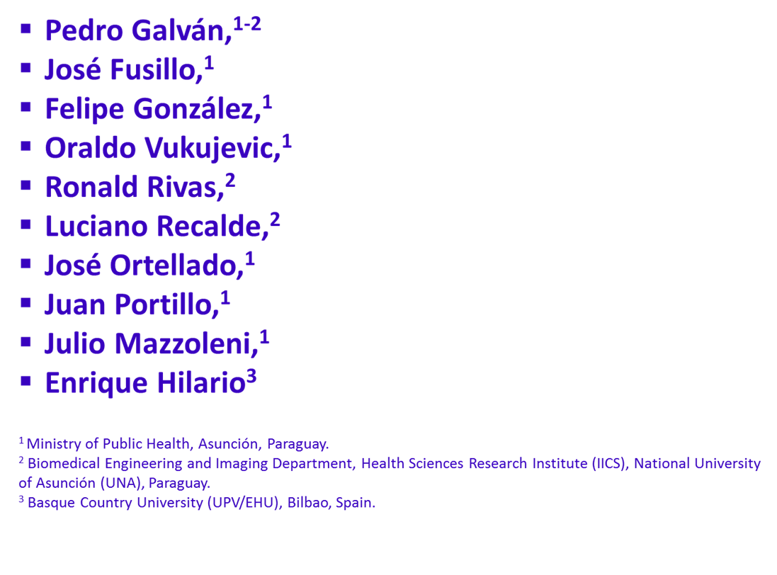
The Team / Workgroup

Slide 3
Description
Creative use of artificial intelligence (AI), information and communication technology (ICT), and medical devices offers opportunities to enhanced health care during the COVID-19 Pandemic. The challenge for clinical and biomedical engineers is to develop AI systems to enhance the global health. Populations living in low setting countries did not have access to specialist care and quality diagnostic services like RT-PCR for COVID-19 and thus depended on the scarce resources of their health system. In this context, the automated AI system for COVID-19 diagnosis based on telemedicine platform should be directed towards alleviating the current lack of highly trained radiologist to perform diagnosis of medical CT imaging at the district and regional hospitals countrywide and serve as a triage to rationalize RT-PCR and human resources in low setting countries. The utility of the automated AI system for COVID-19 diagnosis to mitigate the current global health challenges in Paraguay was investigated.

Slide 4
Goals of the project and final users that will benefit
Explore the utility of automated AI system based on telemedicine platform for COVID-19 diagnosis to expand the role of chest X-ray imaging, using computed tomography (CT) in diagnosing and assessing coronavirus infection at district and regional hospitals across the country so that it can be more than just a screening tool for signs of COVID-19 in patient's lungs.

Slide 5
Results
430 remote diagnoses (screening) were performed between March and August 2020 in 14 districts, regional and specialized (lungs) hospitals across the country.
Of the total, 62.6% corresponded to male and 37.4% to female. The average age of the patients was 50.7 years.
The majority of the COVID-19 patients (59%) were young and in the interval of 19-59 years old.
Both used AI systems (AI1 + AI2) have different background information (fusing molecular, clinical, epidemiological and imaging data) to detect COVID-19, such a system “learns” from abnormalities to arrive at a diagnosis on its own.
The diagnosis of two tailored AI systems implemented in 14 public countryside community hospitals were analyzed comparing clinical characteristics and imaging features.

Slide 6
Results
Four likelihood levels for COVID (low, medium, high and severe) were determined through the two AI systems.
The comparability difference between the two AI diagnosis was 19% for low (0-25%), 65% for medium (25-50%), 53% for high (50-75%) and 64% for severe level.
The most common findings evaluating clinical characteristics and imaging features of COVID-19 on sequential chest CT examinations were severe pneumonia, bilateral pneumonia with pleural effusions, bilateral pulmonary emphysema, diffuse ground glass opacity, etc.
The more important role of CT was in finding lesions and evaluating the effects of treatment.
AI-enhanced telemedicine tool can perform a risk stratification of patients, to decide which type of care they need based on the predicted course of their COVID-19 infection.
Determined AI sensitivity and specificity for COVID were 93% and 80 % respectively, comparing AI-System diagnosis versus RT-PCR.

Slide 7
Pedro GALVAN, ScD., Dipl.-Ing. Biom.
M: ibiomedica@iics.una.py
Telemedicine Directorate, Ministry of Public Health and Welfare (MSPBS) /
Department of Biomedical Engineering and Images (IICS-UNA),
Paraguay

