Slide 1

Using NLP to analyze Epidemiology Trend of COVID-19
Fei Xiaolu
Xuanwu Hospital of Capital Medical University, China

Slide 2
The Team
Xuanwu Hospital of Capital Medical University
Department of Automation,Tsinghua University
Xiaolu Fei, Chief Engineer
Research design & data analysis
Hairong Lv ，Professor
Core algorithm design
Cooperation foundation
natural language processing
semantic analysis
Lan Wei，Senior Engineer
Needs assessment and verification
Pengyu Chen，postgraduate
Data Cleaning
Lan Jiang，postgraduate
Algorithm implementation and optimization.

Slide 3
Description
• The outbreak of COVID-19 is a great challenge for epidemic disease prevention and control in China and the world. A better understanding of the spread mode of COVID-19 will greatly benefit its prevention and control.
• A detailed epidemiological survey was conducted on a large number of confirmed patients in China. The data are in textual format and mainly used for case tracking in the early days. Only after accumulating a amount of data will epidemiologists conduct manual processing and analysis.
If we can segment the textual format data quickly by natural language processing and analyze the word frequency of the identified entities, we may find some COVID-19 transmission features and trends more efficiently.

Slide 4
Description
In this study
• The epidemiology-related patient trajectory reports of Shaanxi Province in January 23-February 22, 2020 and Tianjin City in January 22-February 22, 2020 were collected from the official website of the local Health Commission.
• A bidirectional GRU Conditional Random Field network model was used to perform word segmentation and entity identification.
• The statistics of word frequency and co-word frequency was performed to analyze the epidemiological history trends change.

Slide 5
Goals of the project and final users that will benefit
1) To explore the trends in the contact history of COVID-19confirmed patients in Shaanxi Province and Tianjin City since January 22nd 2020 to February 22nd 2020, and any key sites which should be paid more attention.
2) to verify the feasibility of Natural Language Processing and Big Data analysis techniques in the epidemiological history analysis.

Slide 6
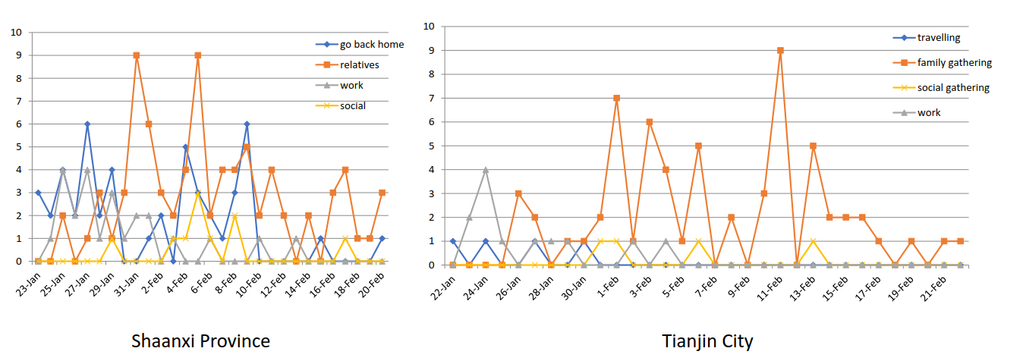
Results
The figures show how the frequency of hot words about the transmission mode in Shaanxi and Tianjin varies over time.

Slide 7
Results
the word “funeral” occurred in the data of Shaanxi Province is worthy of attention

Slide 8
Summary
In this study, Natural language processing and big data analysis techniques are firstly applied to epidemiological history text analysis.
The results showed NLP and big data analysis techniques can reveal the changes more intuitively and quickly and it can be further applied to the analysis of epidemiological transmission modes of new and unknown diseases.

Slide 9
Fei Xiaolu
feixiaolu@tsinghua.org.cn
Xuanwu Hospital of Capital Medical University, China

