Slide 1

Variation in Electrode Impedances After Cochlear Implant Surgery
Yassin Abdelsamad, PhD
Research Dept. Manager, MED-EL, Saudi Arabia

Slide 2
The Team / Workgroup
Dr. Yassin Abdelsamad
Dr. Salman Alhabib
Dr. Medhat Yousef
Dr. Farid Alzhrani
Prof. Abdulrahman Hagr

Slide 3
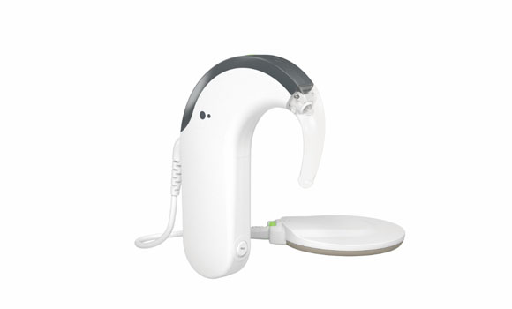
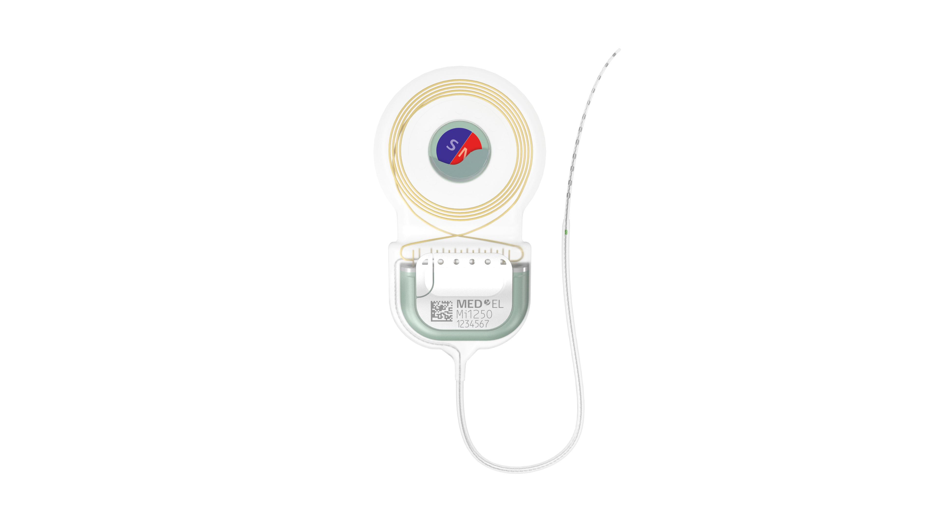
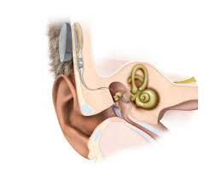
Background
Cochlear Implantation (CI) is a popular surgery performed to treat the hearing impaired with profound sensorineural hearing loss.
Electrode impedance is the resistance to the current flow in the perilymph when a voltage is applied
It’s measured Intra- and Post CI surgery to confirm the device integrity and functionality.
It also help in determining the appropriate levels of electric stimulation and monitoring any unexpected issues.
External Device
Internal Device

Slide 4
Goals of the project and final users that will benefit
Primary Objective: To monitor and assess the variation in the electrical impedance of CI electrode arrays at different time points up to one year after the surgery.
Secondary Objective: To predict the normal variation trending so that the programmers can detect any irregular variations.
Patients, Clinical Audiologists, Clinical Engineers, and CI professionals could get benefits from this work.

Slide 5
Methods and Materials
A retrospective study in KAESC, Riyadh, Saudi Arabia
30 ears implanted with CI and received their external devices after one month from the surgery.
Normal inner ear anatomy;
Implanted with the same electrode array (MED-EL; Flex28);
Implantation was performed through same surgical approach;
Normal intraoperative measurements;
Normal electrode position inside the cochlea.
The electrode impedances along the 12 electrodes of electrode arrays were measured during the activation session and at 3, 6, and 12 months after the surgery.

Slide 6
Results
In the included subjects, the mean electrode impedance measured at the activation session was 7.15 KΩ. Then, this value keeps decreasing till the period of one year.
The recorded values were 6.29, 5.98, and 5.67 KΩ at three, six, and twelve-month after device activation.

Slide 7
Results
For the studied cases, the mean impedance values after one year were significantly lower than the values recorded during the first activation session (20.5% lower, p < 0.05).

Slide 8
Conclusiones
The electrode impedance is very important factor to be measured during and after the CI surgery.
The electrode impedance of the cochlear implant electrode array keeps decreasing gradually after the device activation.
It reaches the stable values after 6 to 12 months regardless the continues increase in the electrical stimulation levels.

Slide 9
Yassin Abdelsamad
Yassin.samad@gmail.com
Cairo, Egypt

