Slide 1


What kind of VR video is BEST for reducing pain
Takafumi Morisaki, Ryosuke Kasai

Slide 2
The Team / Workgroup
Supervisor
Takafumi Morisaki
Department of Clinical Engineering, School of Health Science
Tokyo University of Technology, Japan
Bachelor of Health Science
Chiba Emergency Medical Center, Japan
Clinical Engineer
Ryosuke Kasai
Assistant Professor
Department of Clinical Engineering, School of Health Science
Tokyo University of Technology
Clinical Engineer

Slide 3

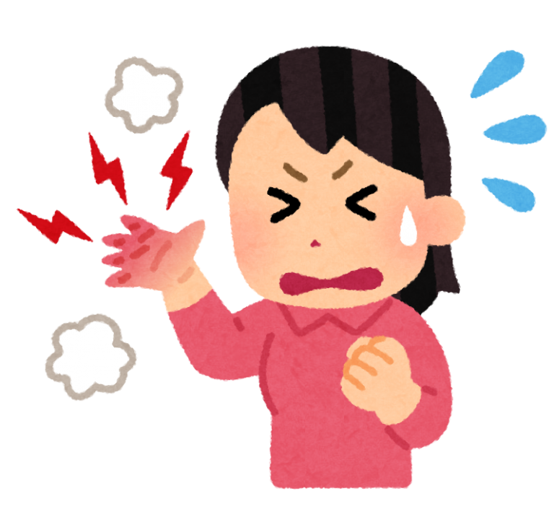

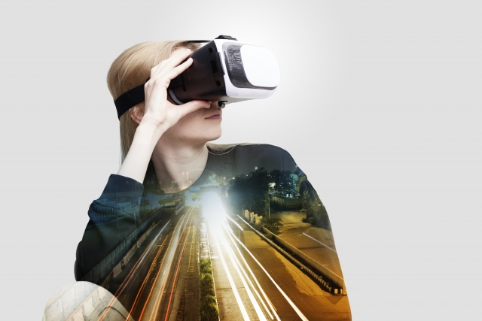
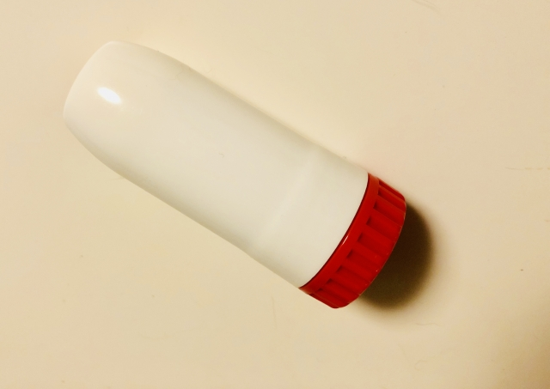
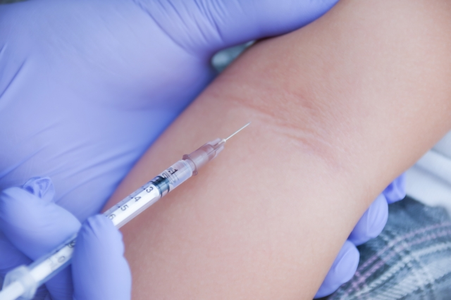
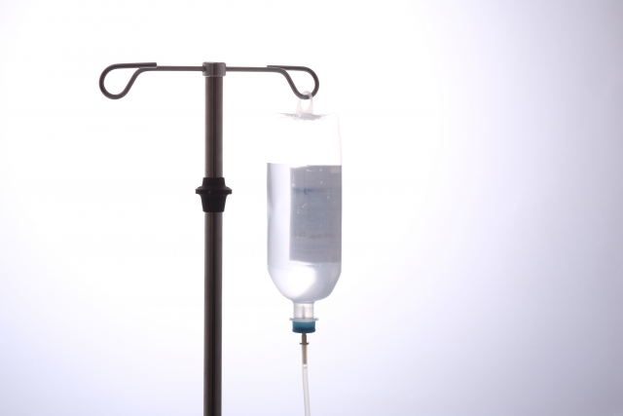
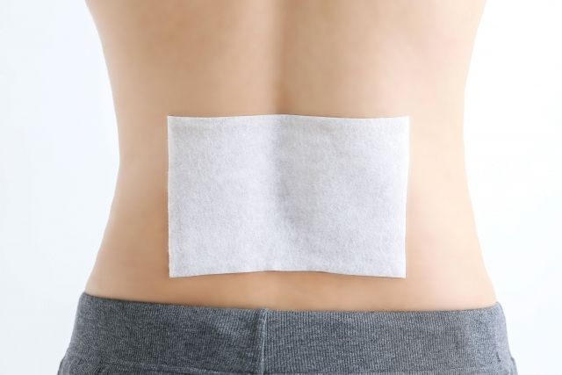
Description
PAIN contributes to a decline in “Quality Of Life” and causes social loss.
VR is a possible way to reduce pain not relying on drugs.
Is DRUG really NECESSARY??
Pictures from acworks

Slide 4
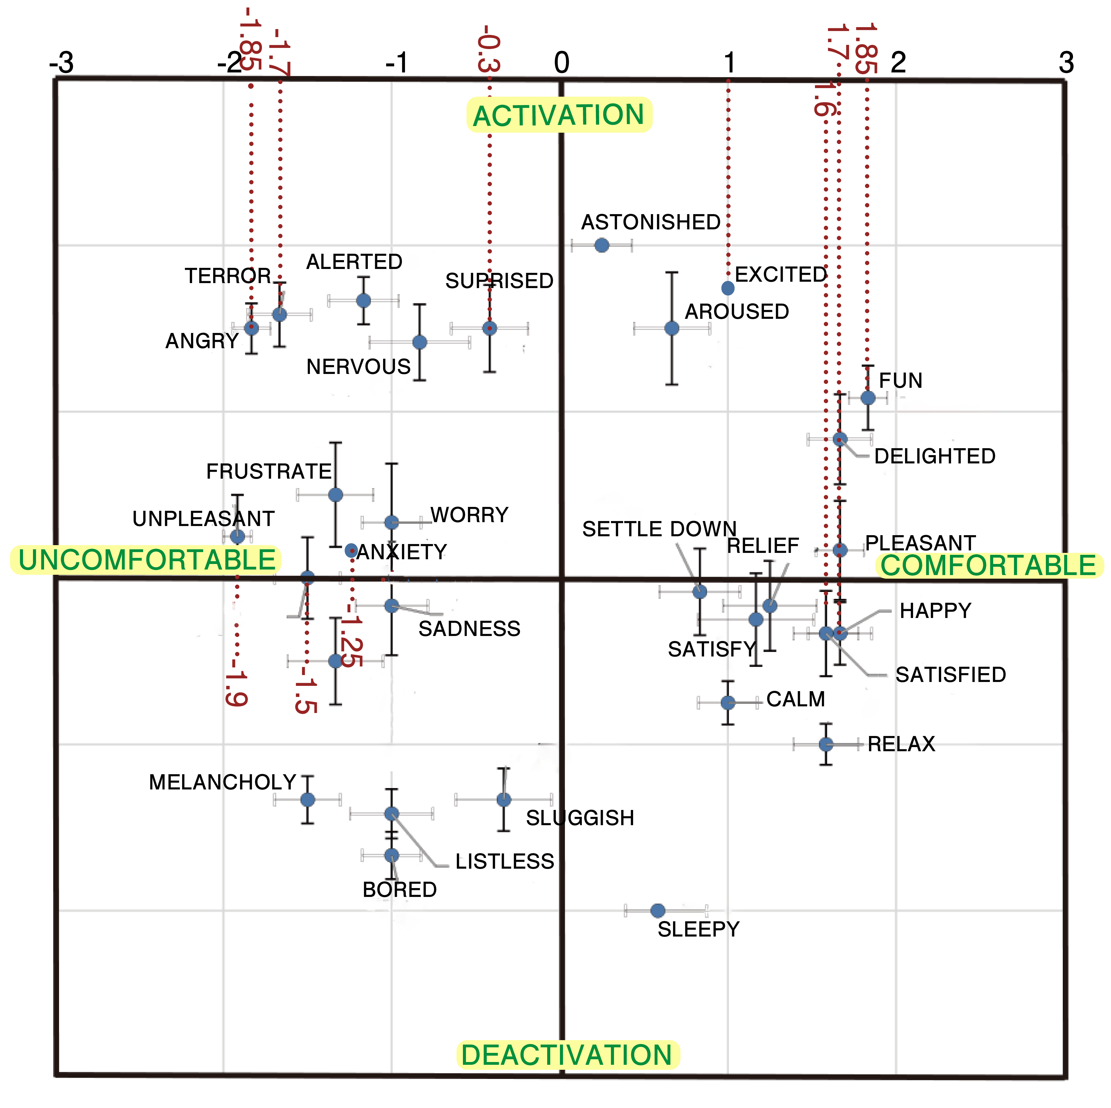
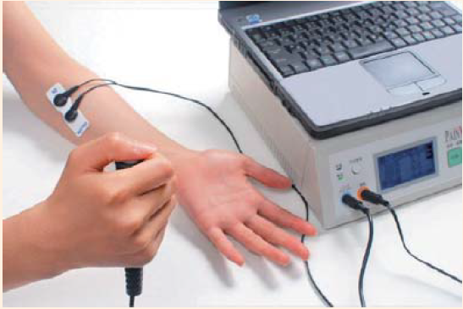
Description
10 participants(early 20’s)
We measured painless level and variation of emotion by VR, and analyzed their correlation using “Russell's circumplex model”.
Relationship between
painless level
and
emotion
Painless level
caused by VR
Variation of emotion by watching VR

Slide 5
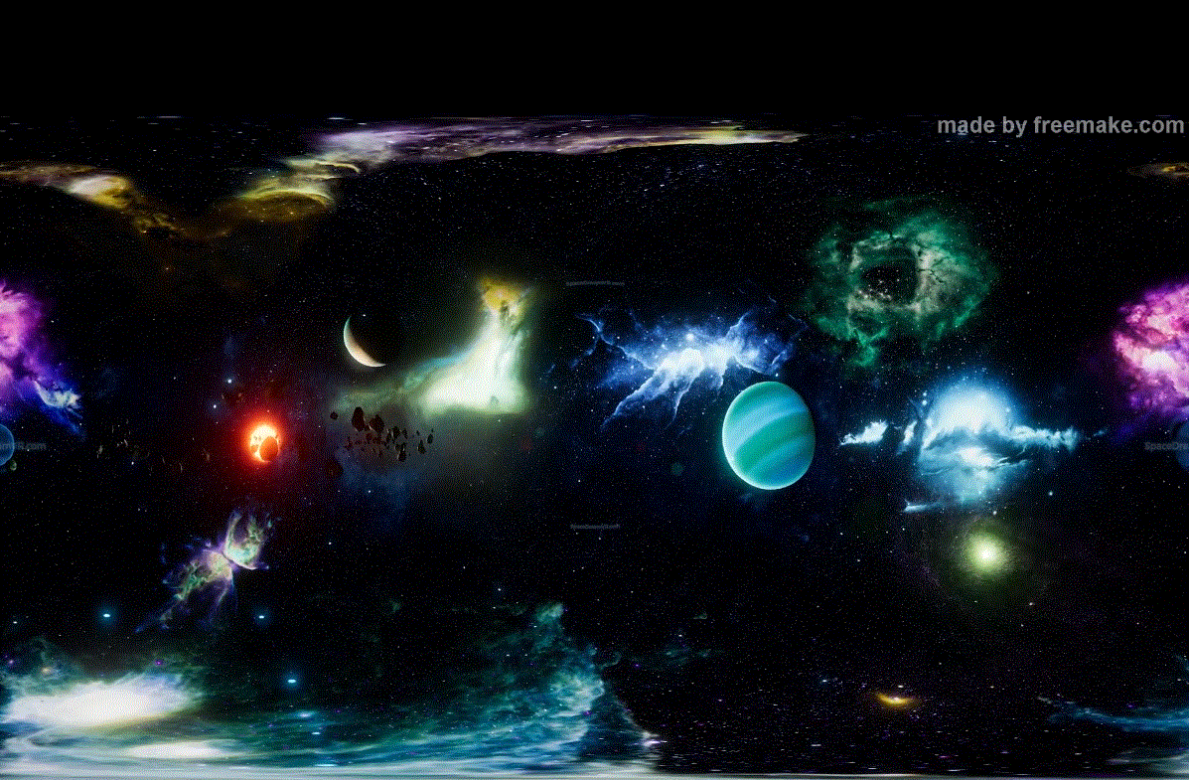
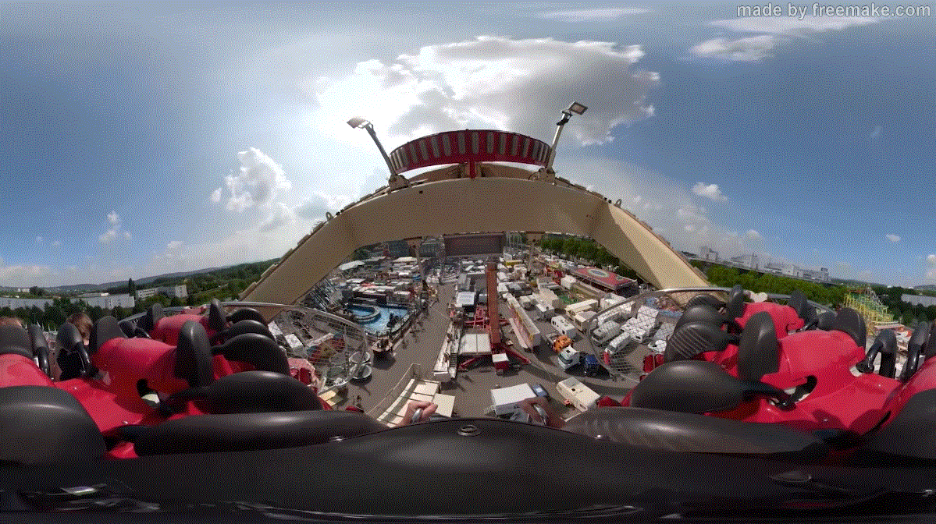
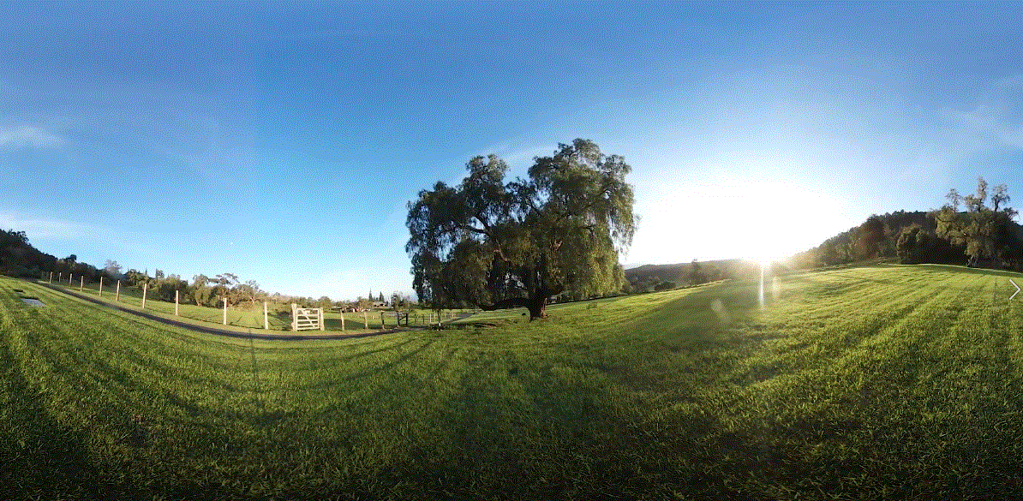
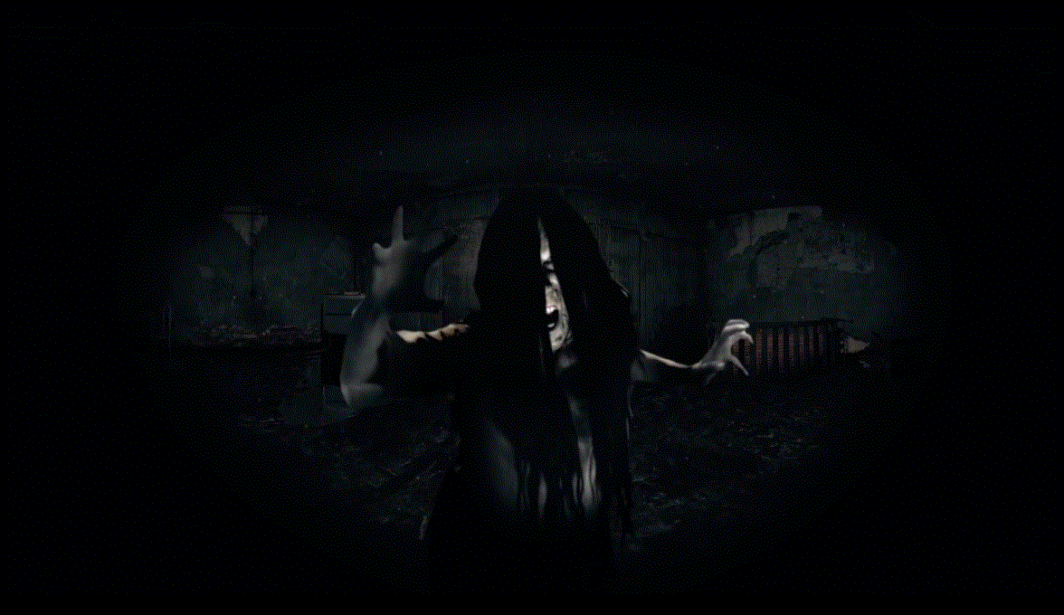
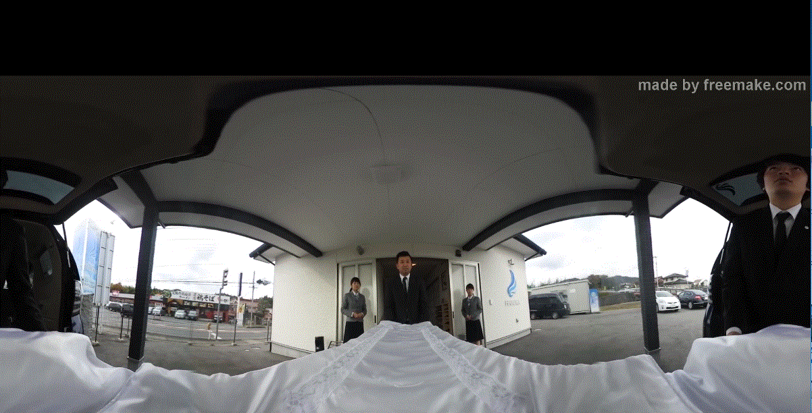
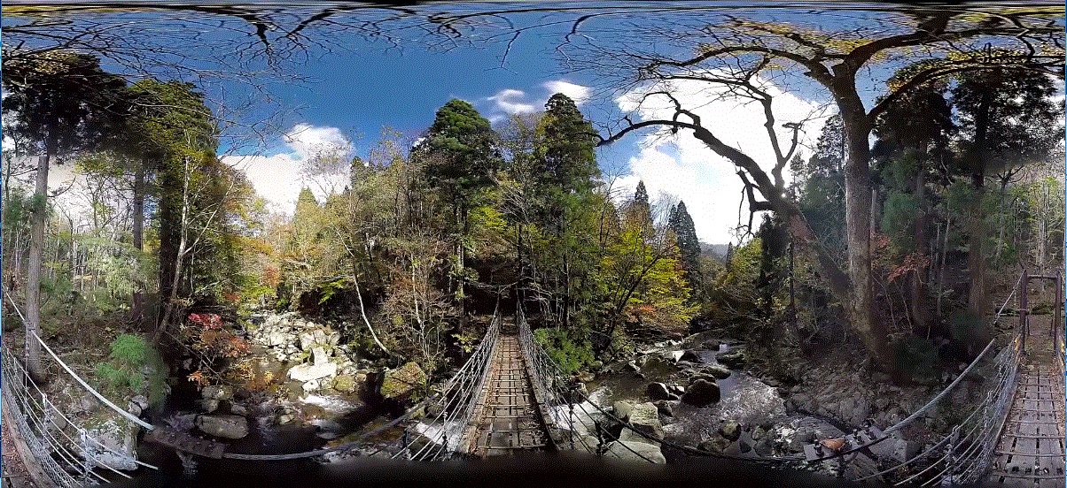
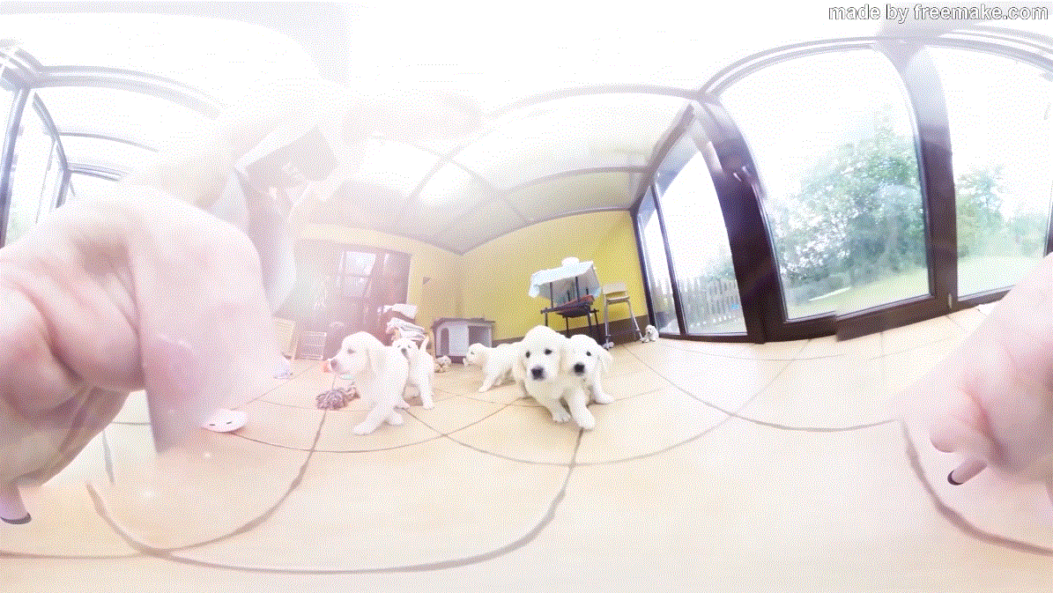
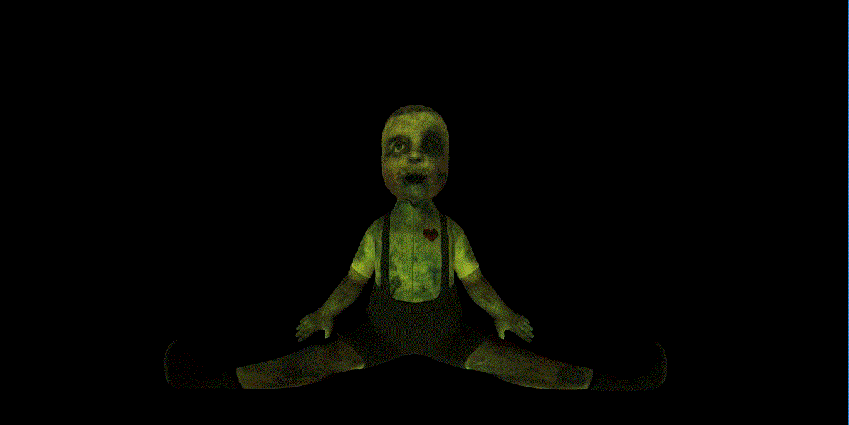
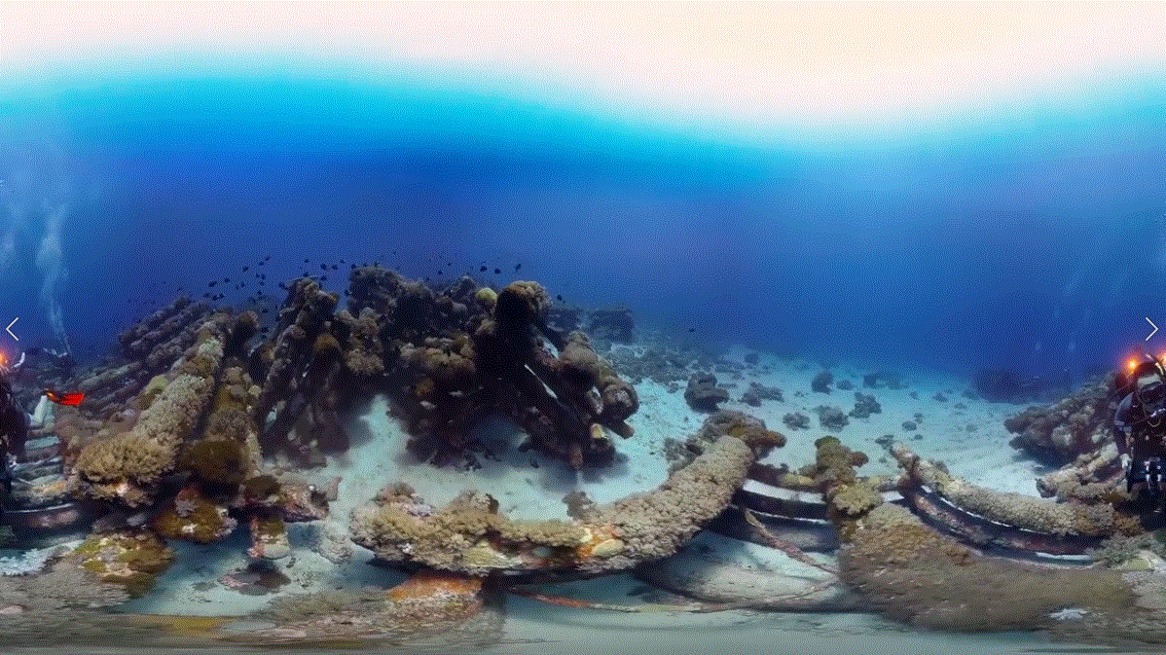
Used VR videos
Seeing the universe Roller coaster Summer grassland
Horror Funeral Rope bridge
Relaxing with dogs Fear Scuba diving

Slide 6
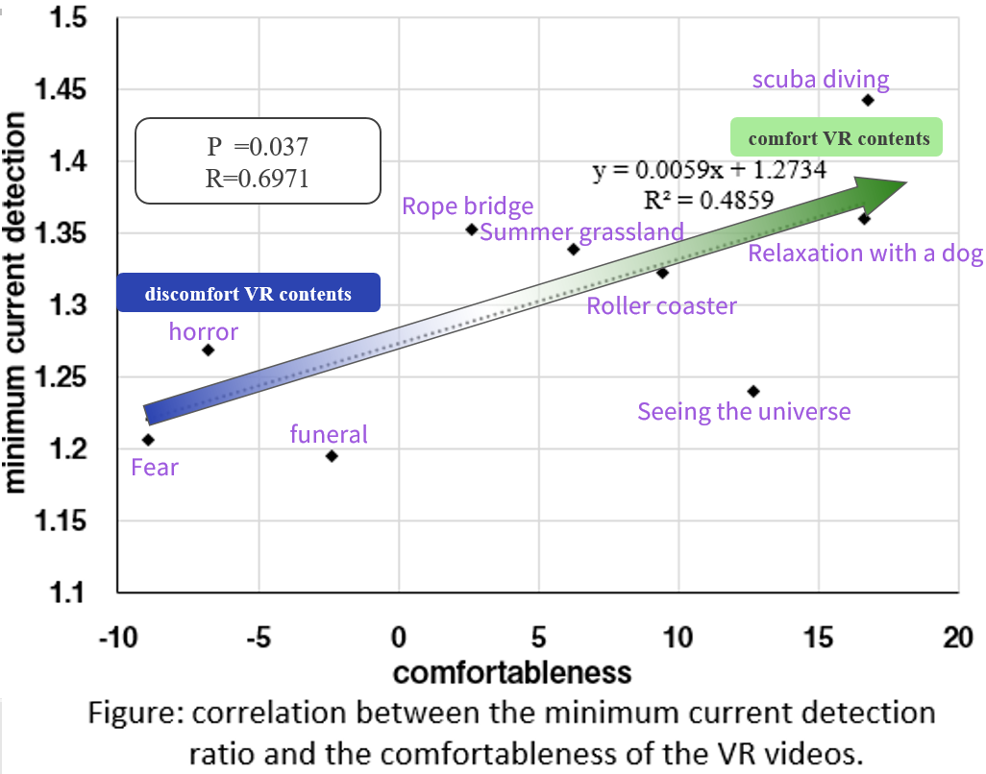


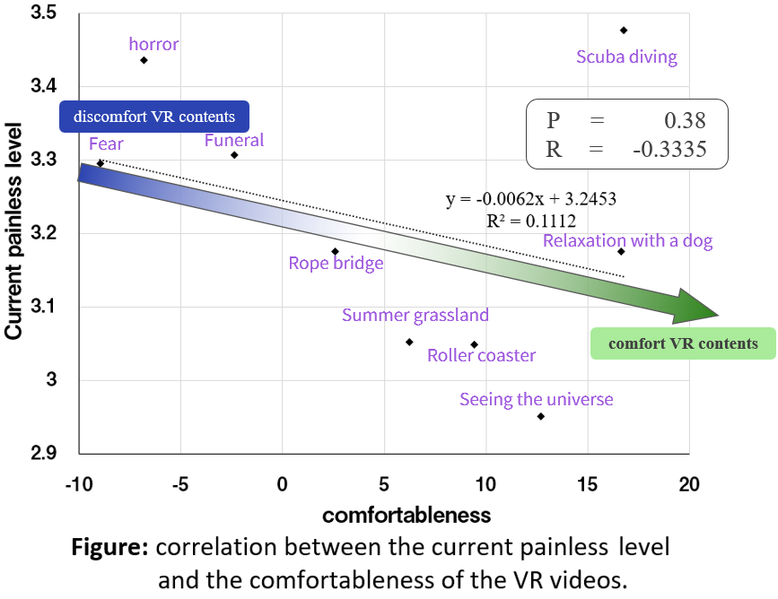
Results
Comfortable VR videos delays sensing current
Uncomfortable VR videos quickens sensing current
Comfortable VR videos quickens feeling pain
Uncomfortable VR videos delays feeling pain
TO STOP sensing PAIN itself
Comfortable VR videos may be useful
TO REDUCE PAIN
Uncomfortable VR videos may be useful

Slide 7
Goals of the project and final users that will benefit
Goal of the project
  Understand the relationship between painless level x emotion caused by different VR contents
Future aim
  Identify what VR contents is best to reduce PAIN
Final Users
  Everybody that suffers from pain and anticipates VR to be a drug-free pain reducing technology.
image: Freepik.com

Slide 8
Takafumi Morisaki
h2117077cd@edu.teu.ac.jp
Tokyo University of Technology, Japan
Ryosuke Kasai
ryo.n315@icloud.com
Tokyo University of Technology, Japan

