Slide 1

Women in Clinical Engineering as leaders in Healthcare
What can everyone learn from their knowledge and experience
Dikeldi Modipia
Priyanka Upendra, MS, CHTM, AAMIF
Jennifer DeFrancesco, DHA, FACHE, CHTM
Shija Daniels, B Eng, PGDBA

Slide 2
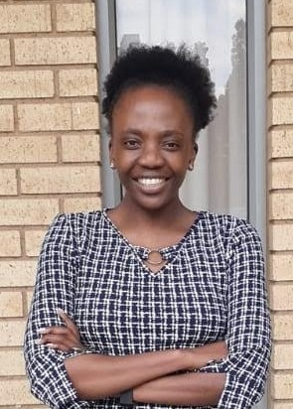

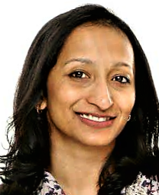
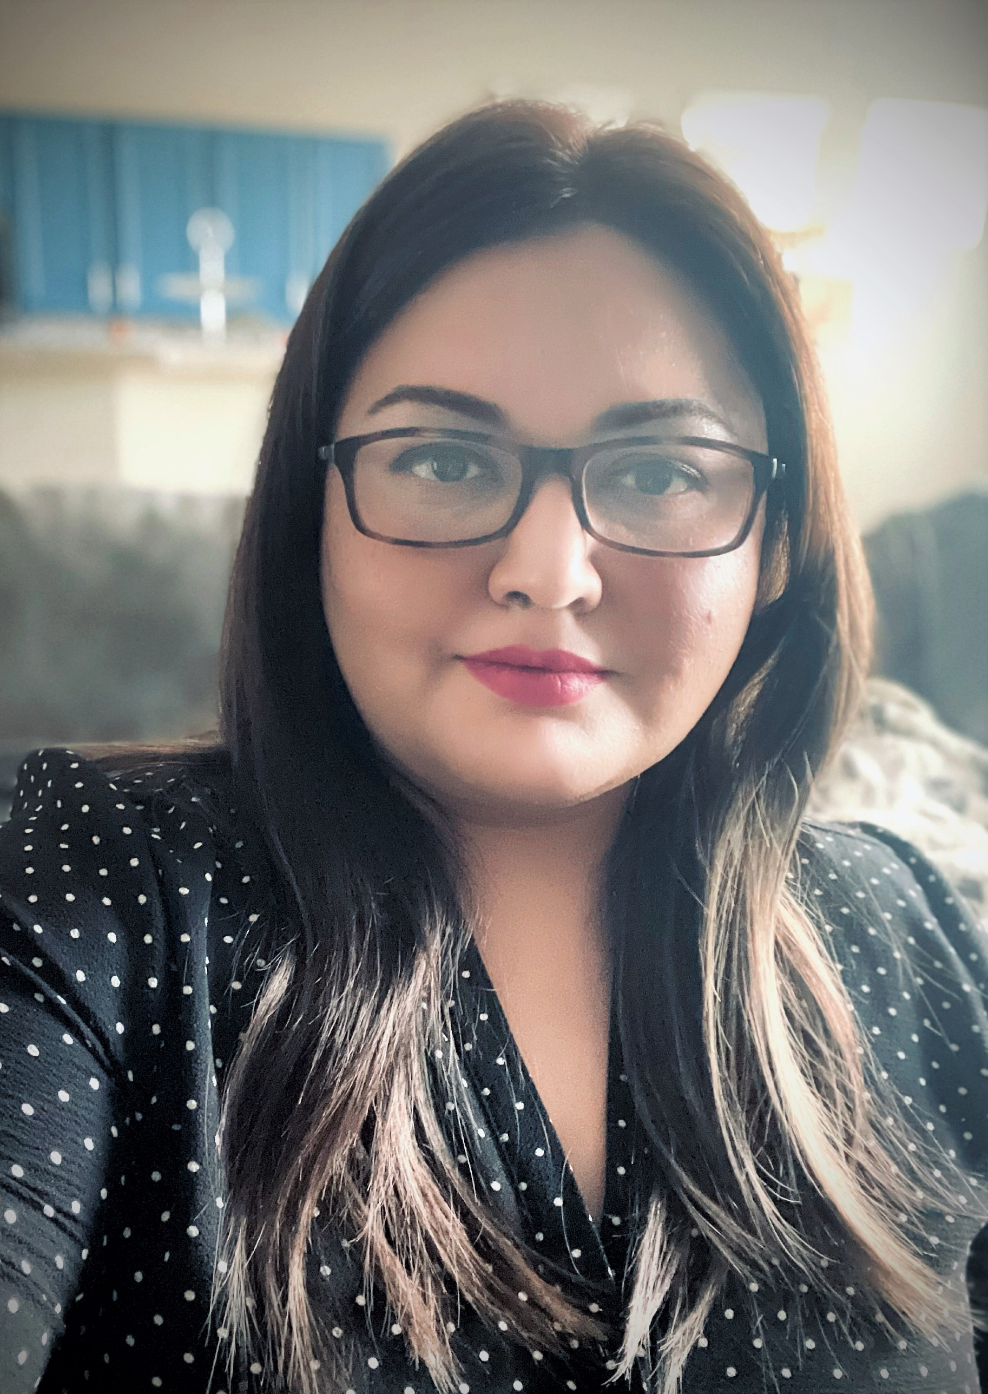
The Team / Workgroup
Dikeledi Modipa
South Africa
Priyanka Upendra, MS, CHTM, AAMIF
Director, Customer Success
USA
Jennifer DeFrancesco
Associate Medical Center Director
USA
Shija Daniel
Clinical Engineering Specialist
South Africa

Slide 3
Description
This team Will illustrate the perspective women in Clinical engineering and their role in healthcare delivery as well as share their unique perspectives and experiences.

Slide 4
Dikeldi Modipa
What and who are clinical engineering technicians ?
How do they factor into the running of the hospital ?
How can we ensure that the clinical engineering technicians are supported ?
What can be learnt from clinical engineering technicians and the actual department?
How do we ensure the continuation and growth of the industry ?

Slide 5
Priyanka Upendra
Unique skillsets women leaders bring to the HTM/CE field:
  Emotional intelligence to influence a diverse population
  Ability to adapt to changing technological and programmatic trends
  Exclusive communication skills that drive quality interactions with clinicians and HTM/CE team members
Challenges women leaders face in the HTM/CE field:
  Disparities related to age and gender
  Indifferent perception of communication skills
  Ability to express confidently while addressing a diverse population

Slide 6
Jennifer DeFrancesco
Importance of acquired diversity in Clinical Engineering or strengthening of patient outcomes organizational goals
  Diverse patient populations necessitate diverse skill sets in healthcare staff
Need to understand patient needs and values, especially in “post-covid” time
Public Health & International Health
  Daily Work
  Research
  Publication
  Don’t be afraid to use CE skills and data in more closely related health delivery paradigms
Need for standardization
Sweat equity

Slide 7
Shija Daniel
CE Value Proposition:
Lack of Recognition
Changing dynamics
Positioned for success

Slide 8
Jennifer DeFrancesco
jdefrancesco21@gmail.com
CED Collaborator, USA

